Slide 2
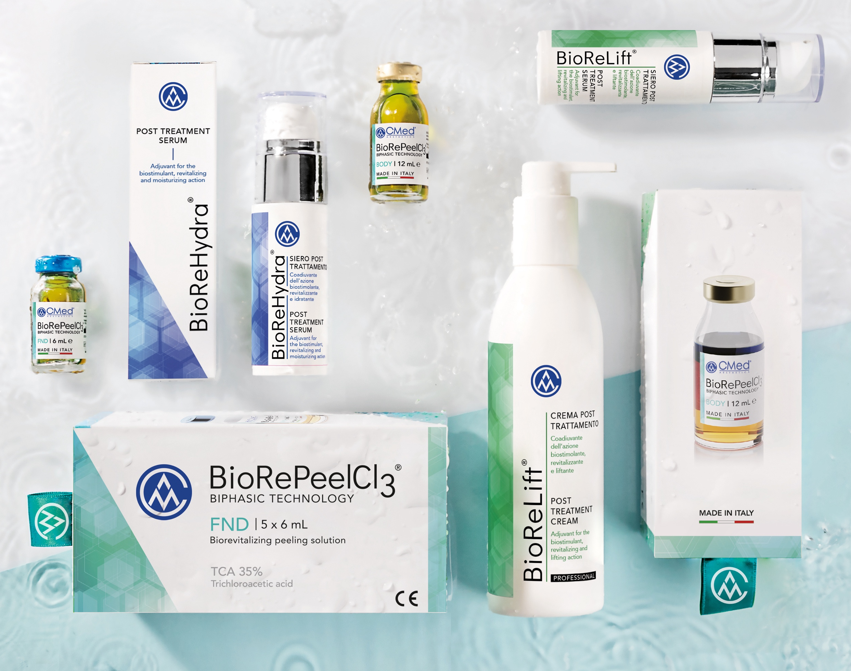
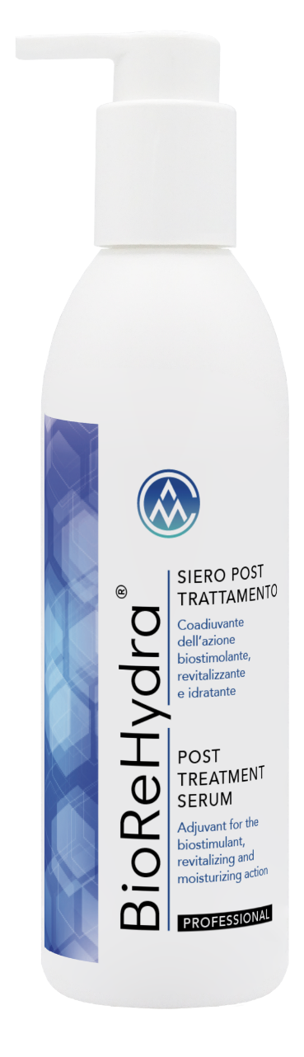
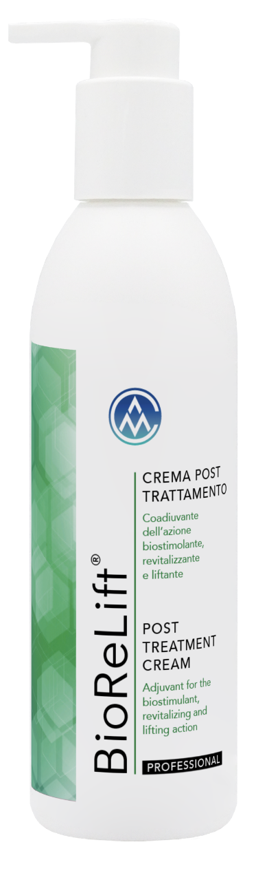
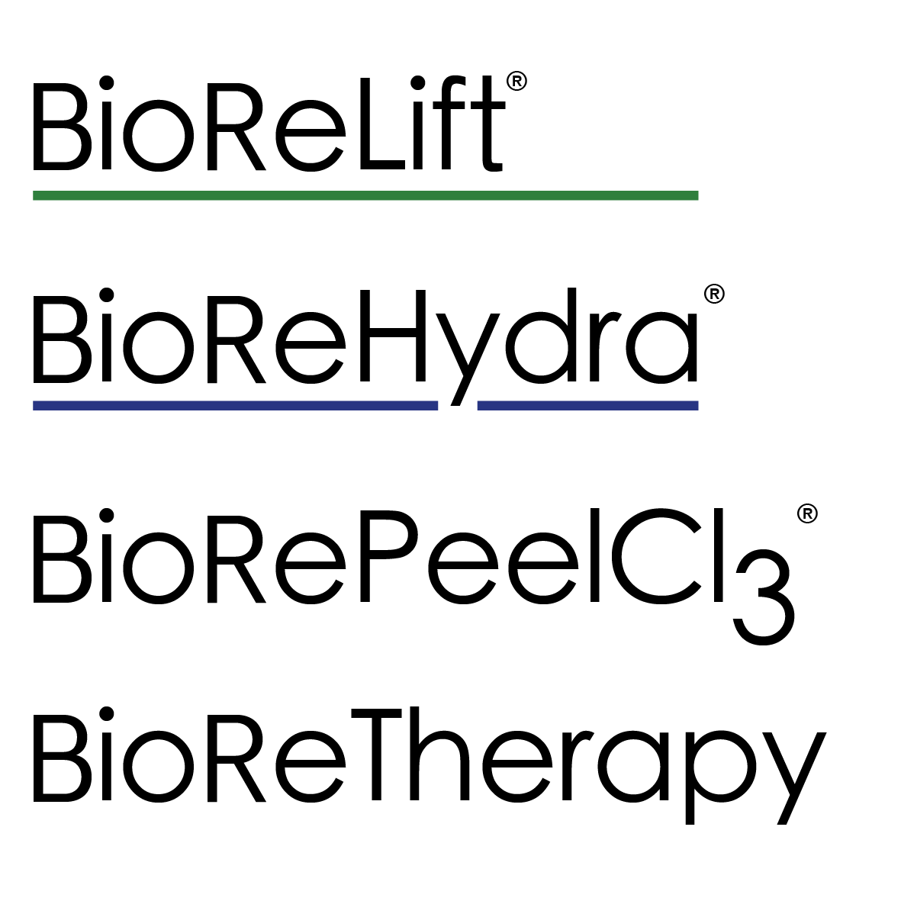

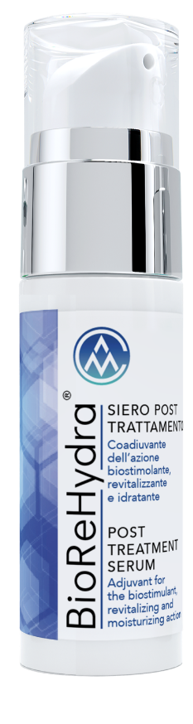
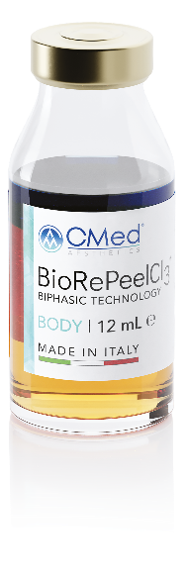

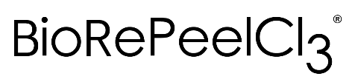
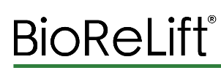

REVITALIZING, ANTIOXIDANT and MOISTURIZING treatment for FACE and BODY
FND
BODY

Slide 3


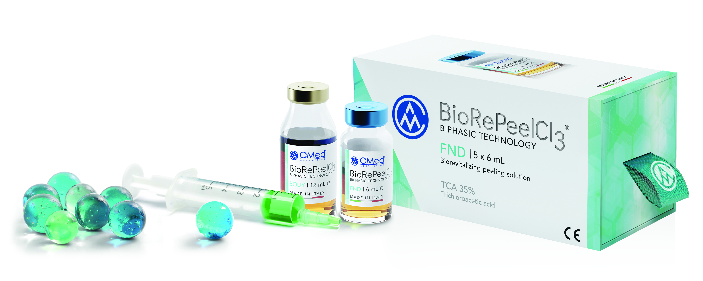
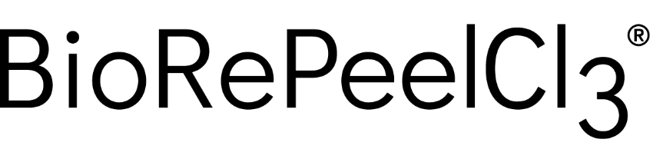
BIPHASIC TECHNOLOGY

Slide 4
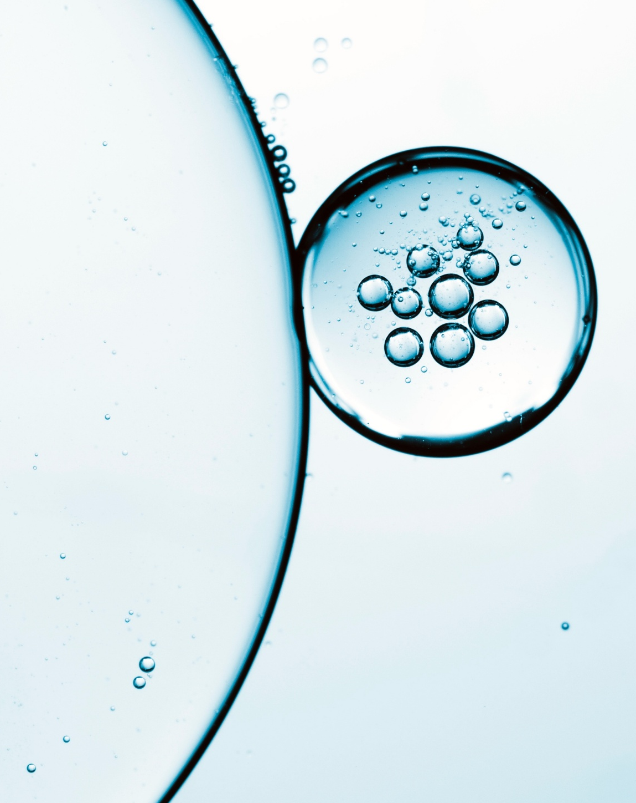
BIPHASIC TECHNOLOGY
Why is it important?
MONOPHASIC TCA
Preservation in fridge
Oxidation and denaturation
Unstable products
Darkening
BIPHASIC FORMULATION
Room temperature stability
No TCA oxidation
No formulation darkening and degradation
Functionalized lipophilic phase

Slide 5
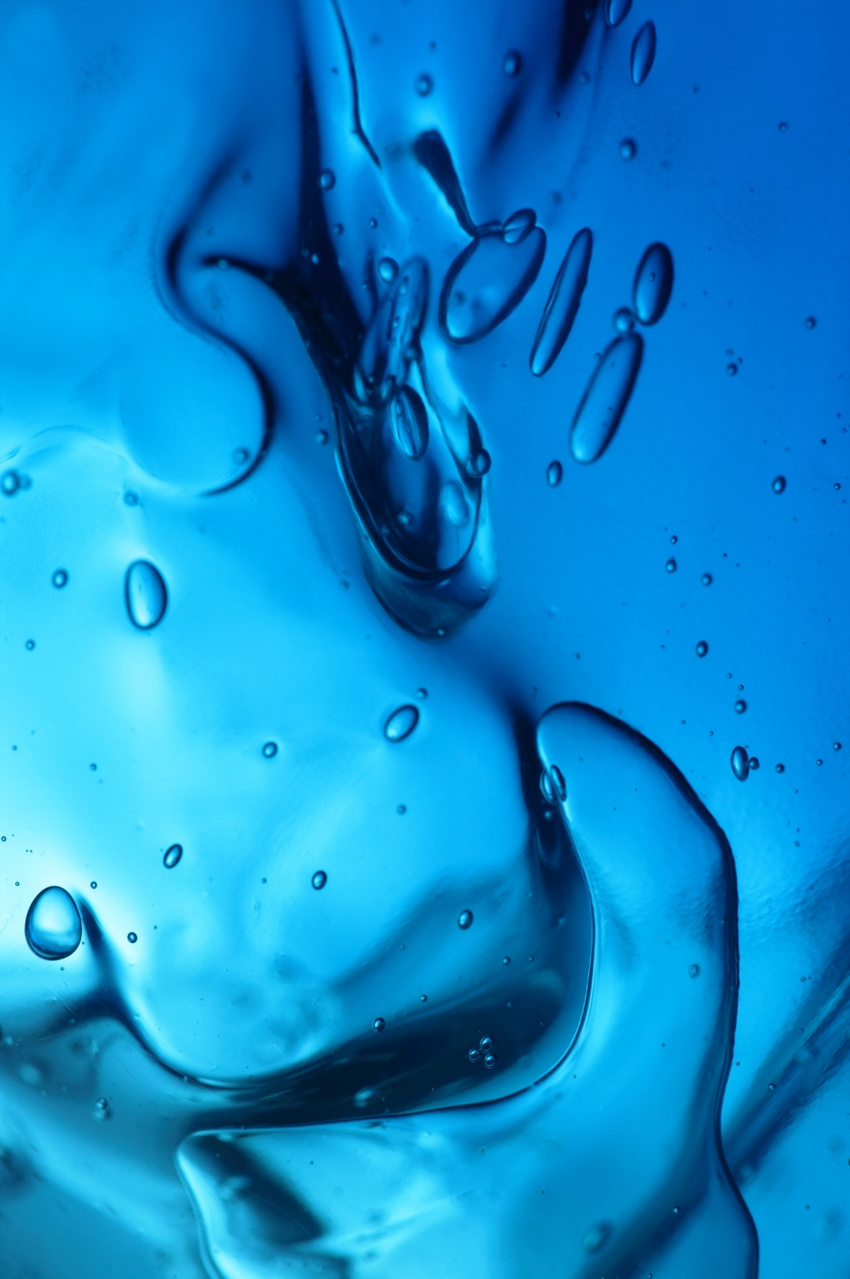
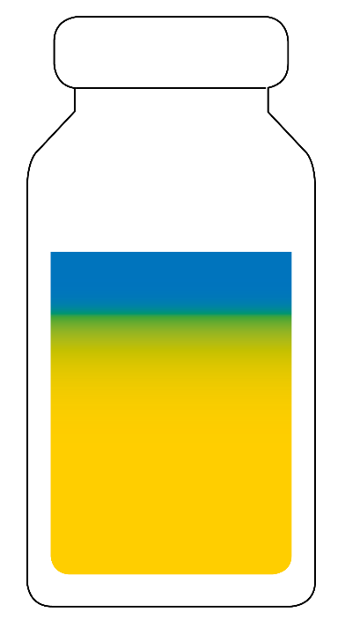
LIPOPHILIC PHASE ACTIONS
ACTIONS
Stabilizing and protective
It prevents trichloroacetic acid oxidation and stabilizes the formulation separating the aqueous phase from the oxidating atmosphere inside the ampoule. It consequently improves the performance and effectiveness of the product.
Film formation and vehiculating
It reduces trans-epidermic water evaporation and assists active principles’ vehiculation.
Regenerating
It restores and maintains cutaneous hydro-lipidic film.
Moisturizing
It increases hydration through direct and indirect mechanisms.

Slide 6
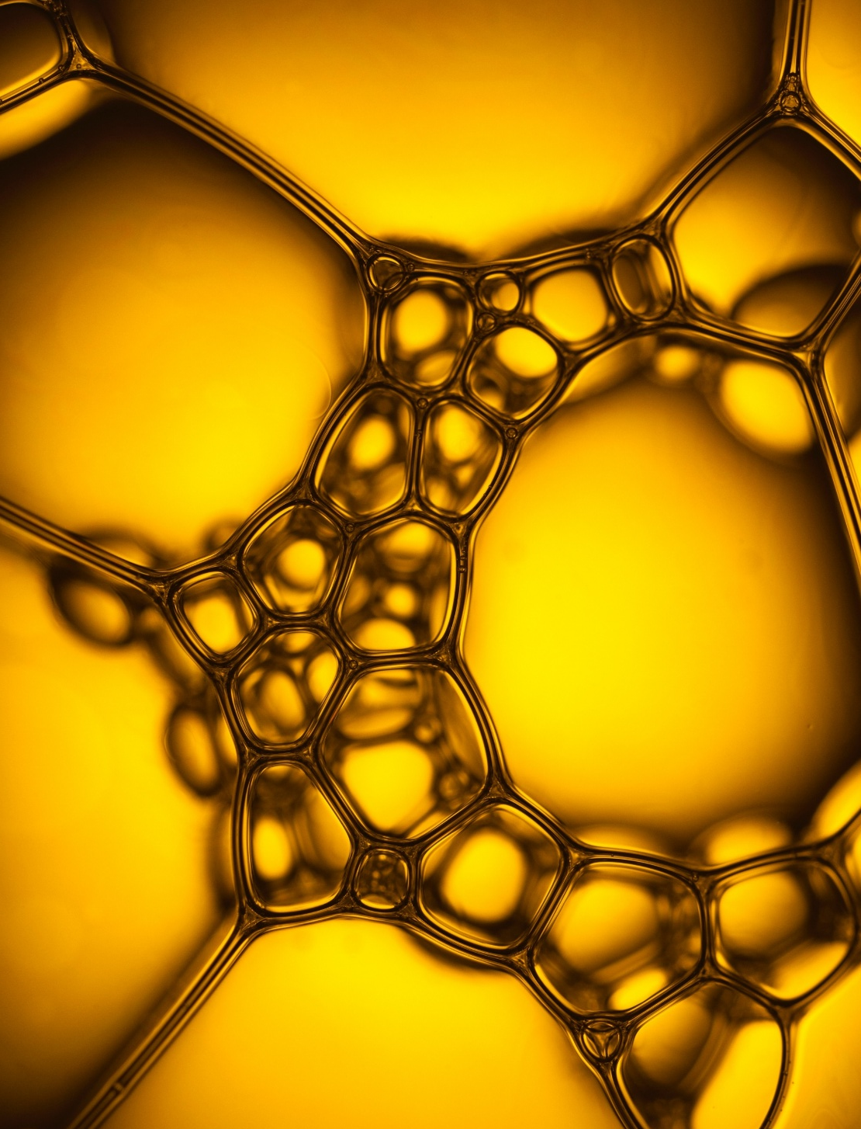
HYDROPHILIC PHASE
ACTIONS
Biostimulating
It stimulates fibroblasts’ activity and activates cutaneous proliferating and biosynthetic processes.
Revitalizing
It increases cellular turnover and production of collagen, elastin and hyaluronic acid.
Keratolytic and peeling
It removes outer cells of stratum corneum by breaking corneocytes’ adesion bonds.
This process promotes active principles penetration.
Anti acne enlarged pores comedones
It helps battling acne, it eliminates comedones and it has an astringent effect on enlarged pores.

Slide 7
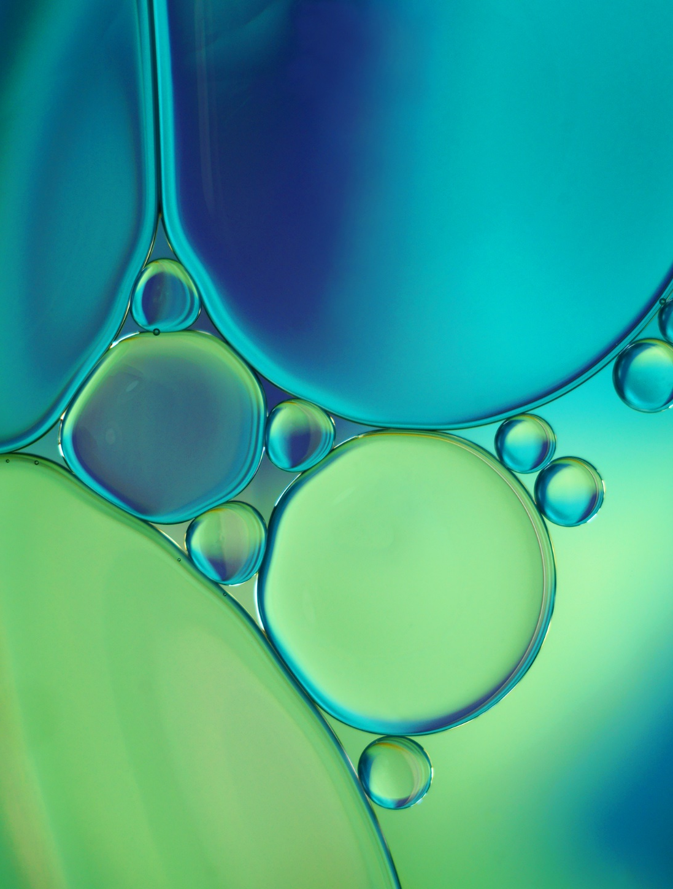
BIPHASIC TECHNOLOGY
Overview
The lipophilic phase floats on the hydrophylic phase protecting it from the oxygen inside the bottle.
The mechanic barrier stabilizes the hydrophilic phase: TCA and other active ingredients do not oxidize.
The density difference between the two phases guarantees constant protection even after shaking.

Slide 8

FEATURES
4 FUNCTIONAL COMPLEXES
GLYCINE
PROLINE
HYDROXYPROLINE
VITAMIN C
NO NEEDLES
PAINLESS
FAST
MULTIFUNCTIONAL
IMMEDIATE RESULT
NO POST TREATMENT SIGNS
FOR THE WHOLE BODY
FOR ALL AGES
FOR ALL SKIN TYPES
FOR ALL SEASONS
NO PHOTOSENSIBILIZATION
Bio
Re
GABA
ARGININE
RIBOFLAVIN
TCA
LACTOBIONIC ACID
SALICYLIC ACID
TARTARIC ACID
CITRIC ACID
Peel
Lip
SQUALANE
ISOPROPYL MYRISTATE

Slide 9
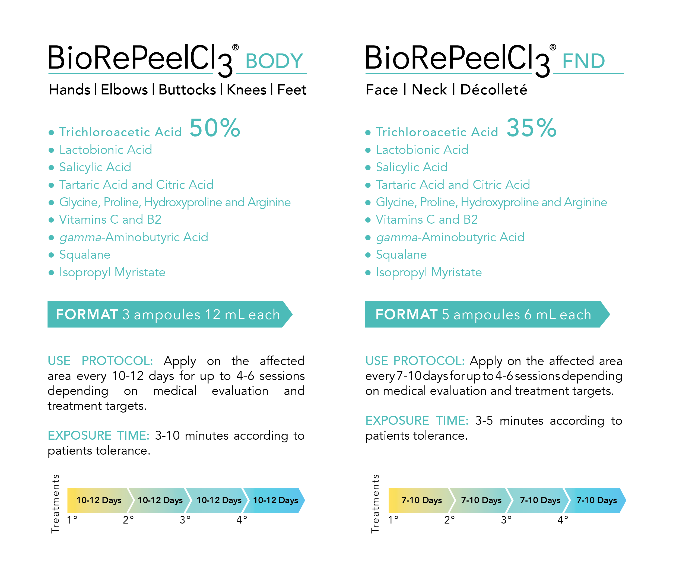
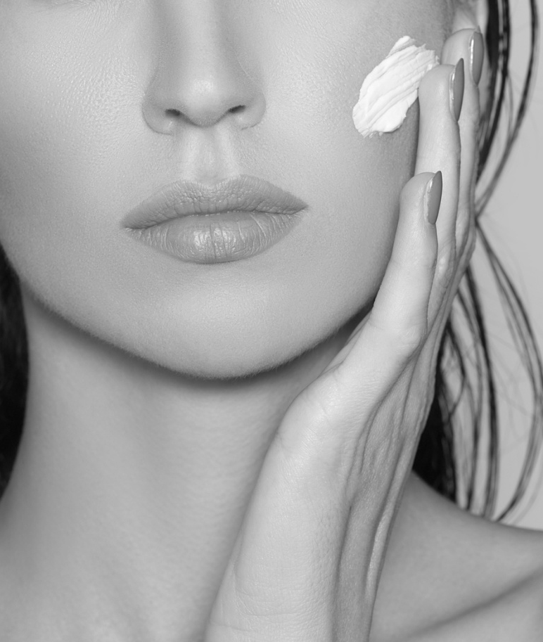
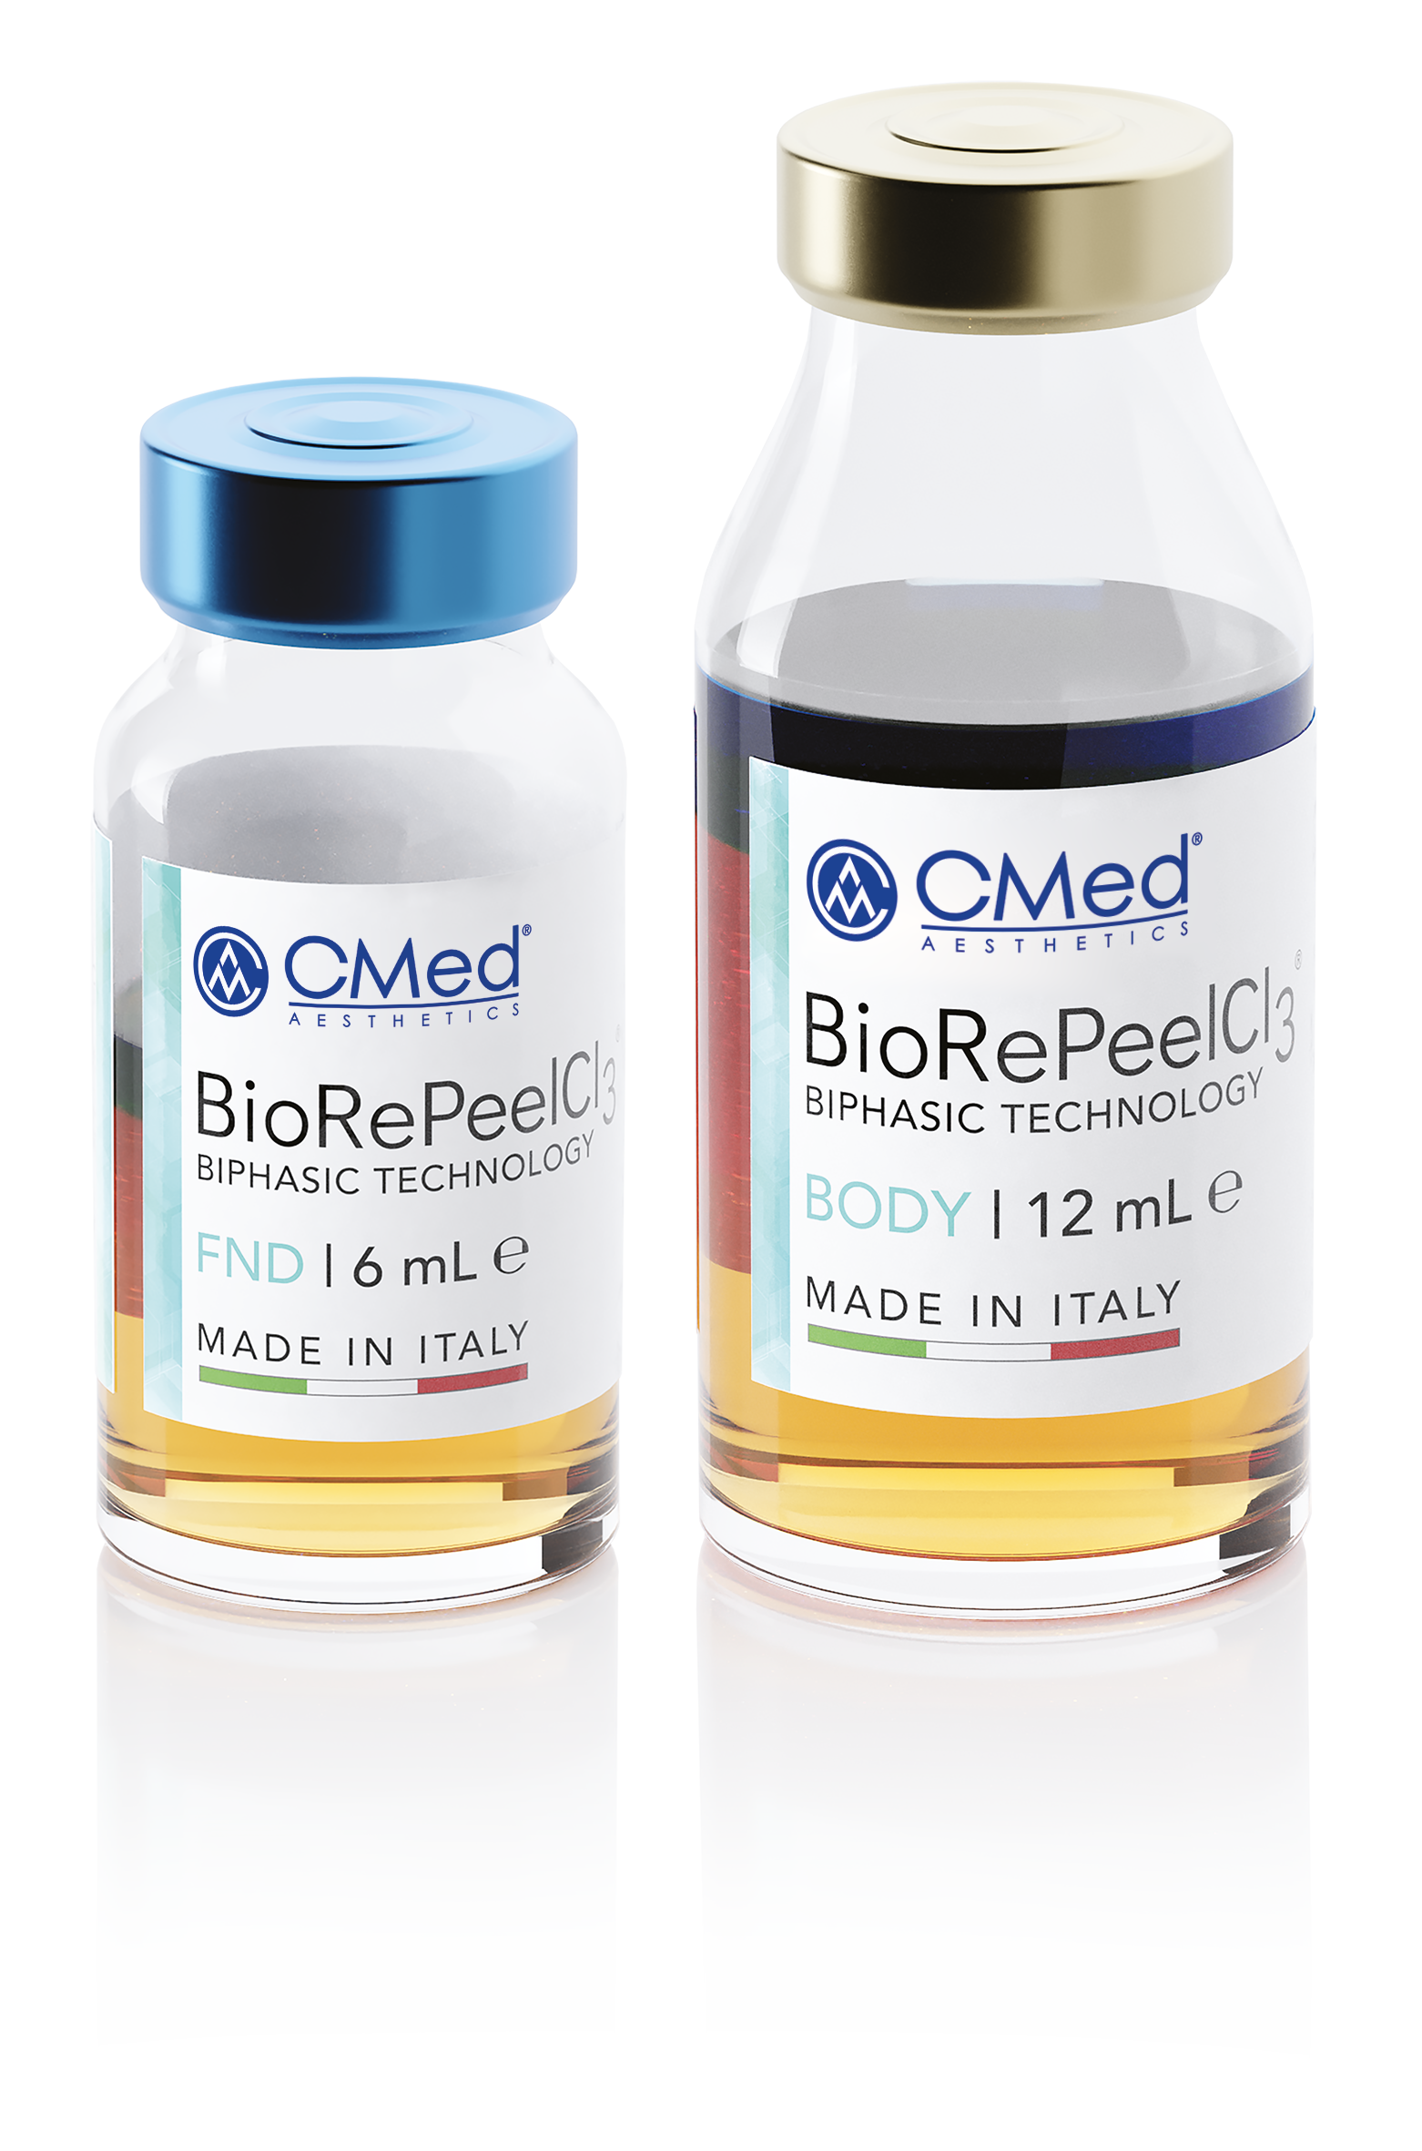

Slide 10


Slide 11
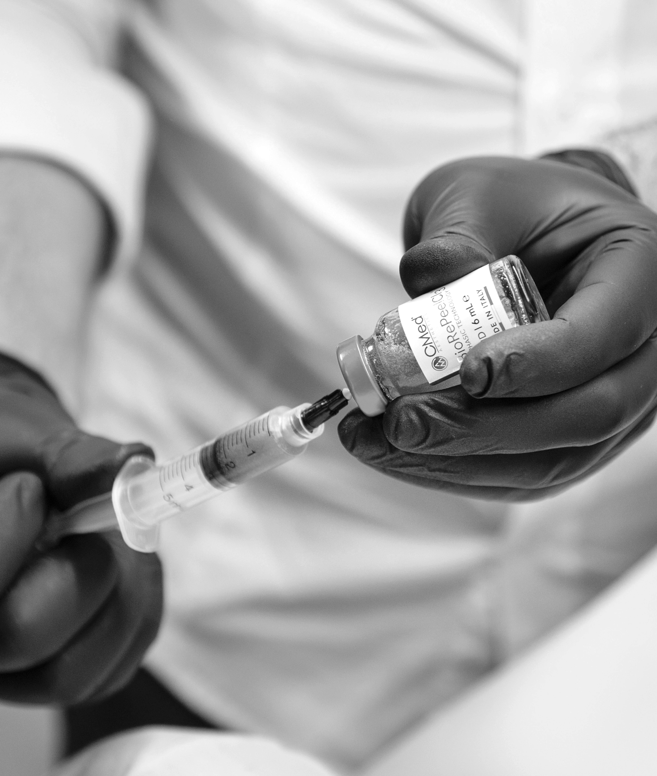
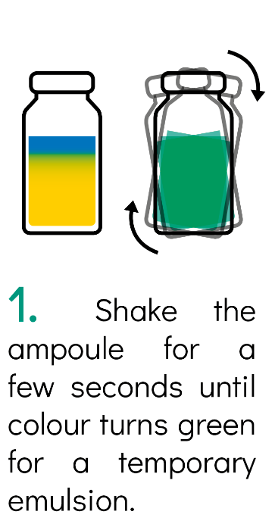

Application
1.
2.
3.
4.
N.B. After a few minutes the product will return to its initial biphasic state.
It is necessary to shake the ampoule before every use.

Slide 12
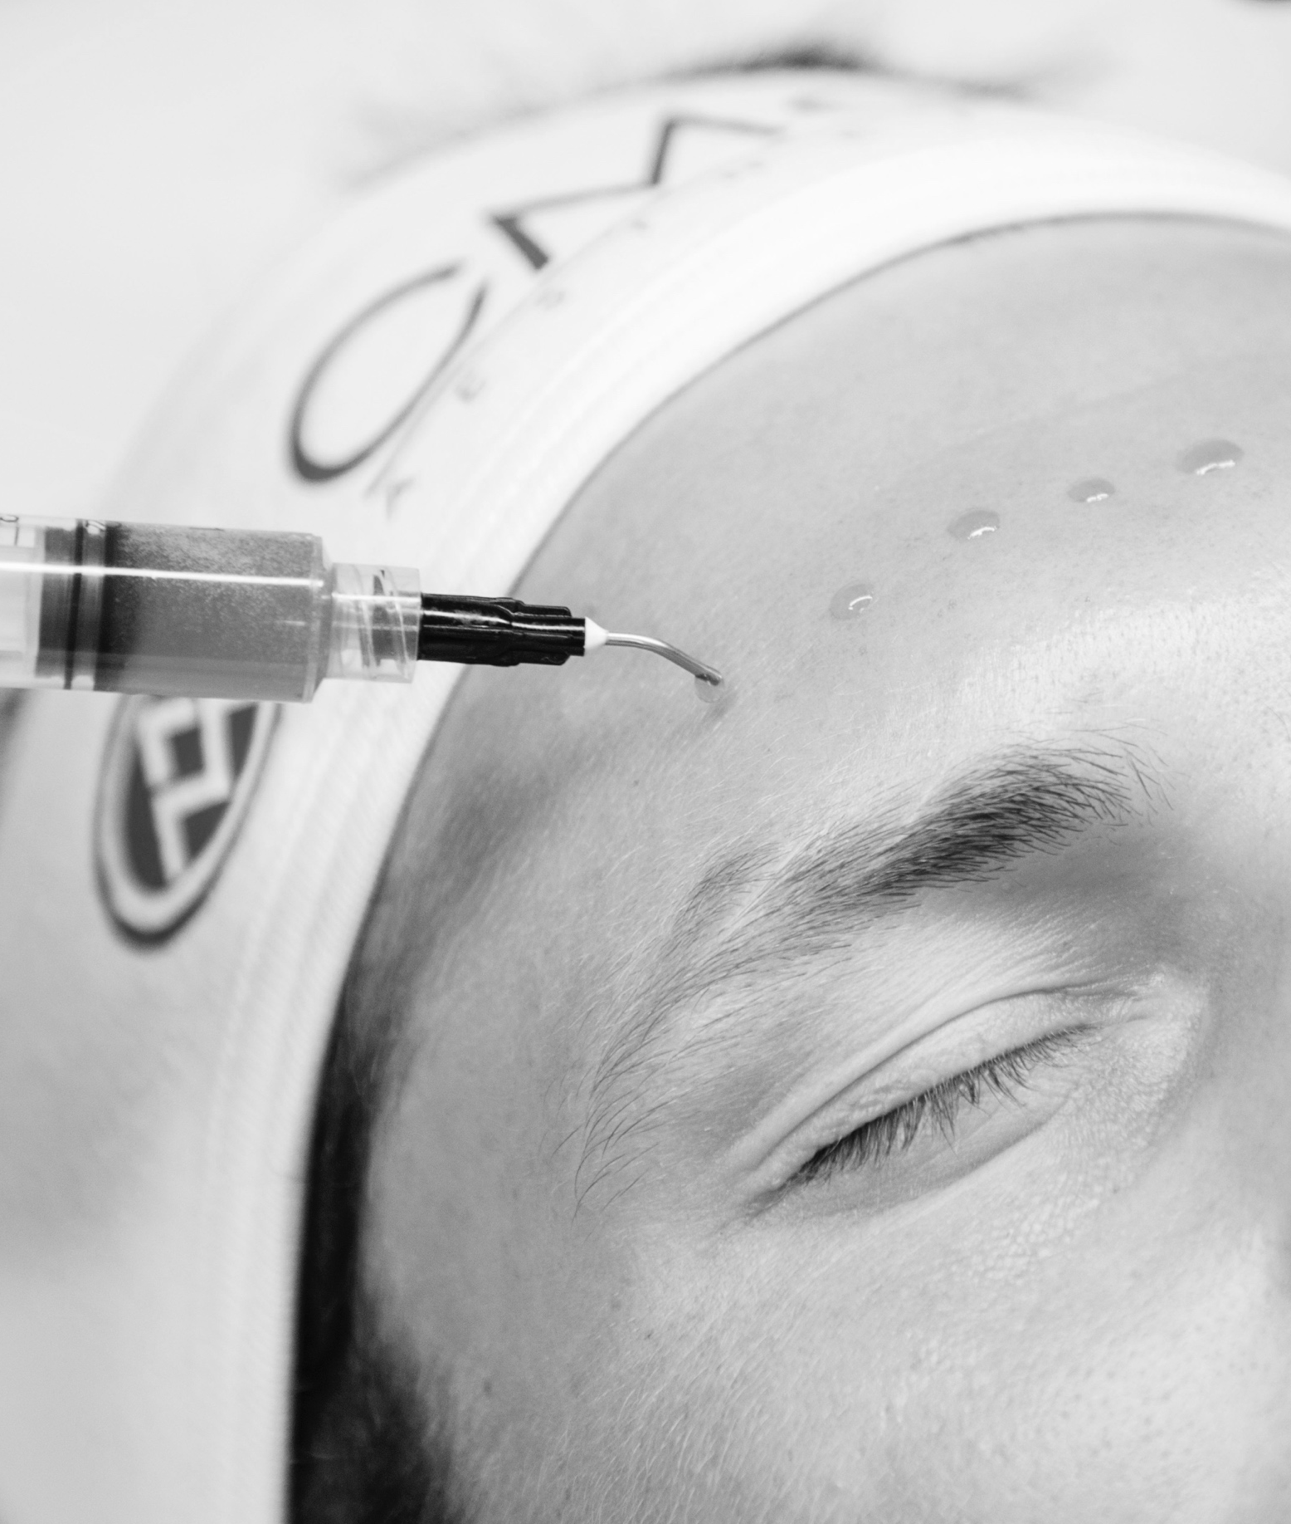
Associations
You can use BioRePeelCl₃® also in synergy with other treatments to improve their performance and result:
KIND OF TREATMENT | WHEN
INJECTABLE TREATMENTS | Before
PHOTO STIMULATION | Before
RAFIOFREQUENCY | After
TOPICAL TREATMENT | Before

Slide 13
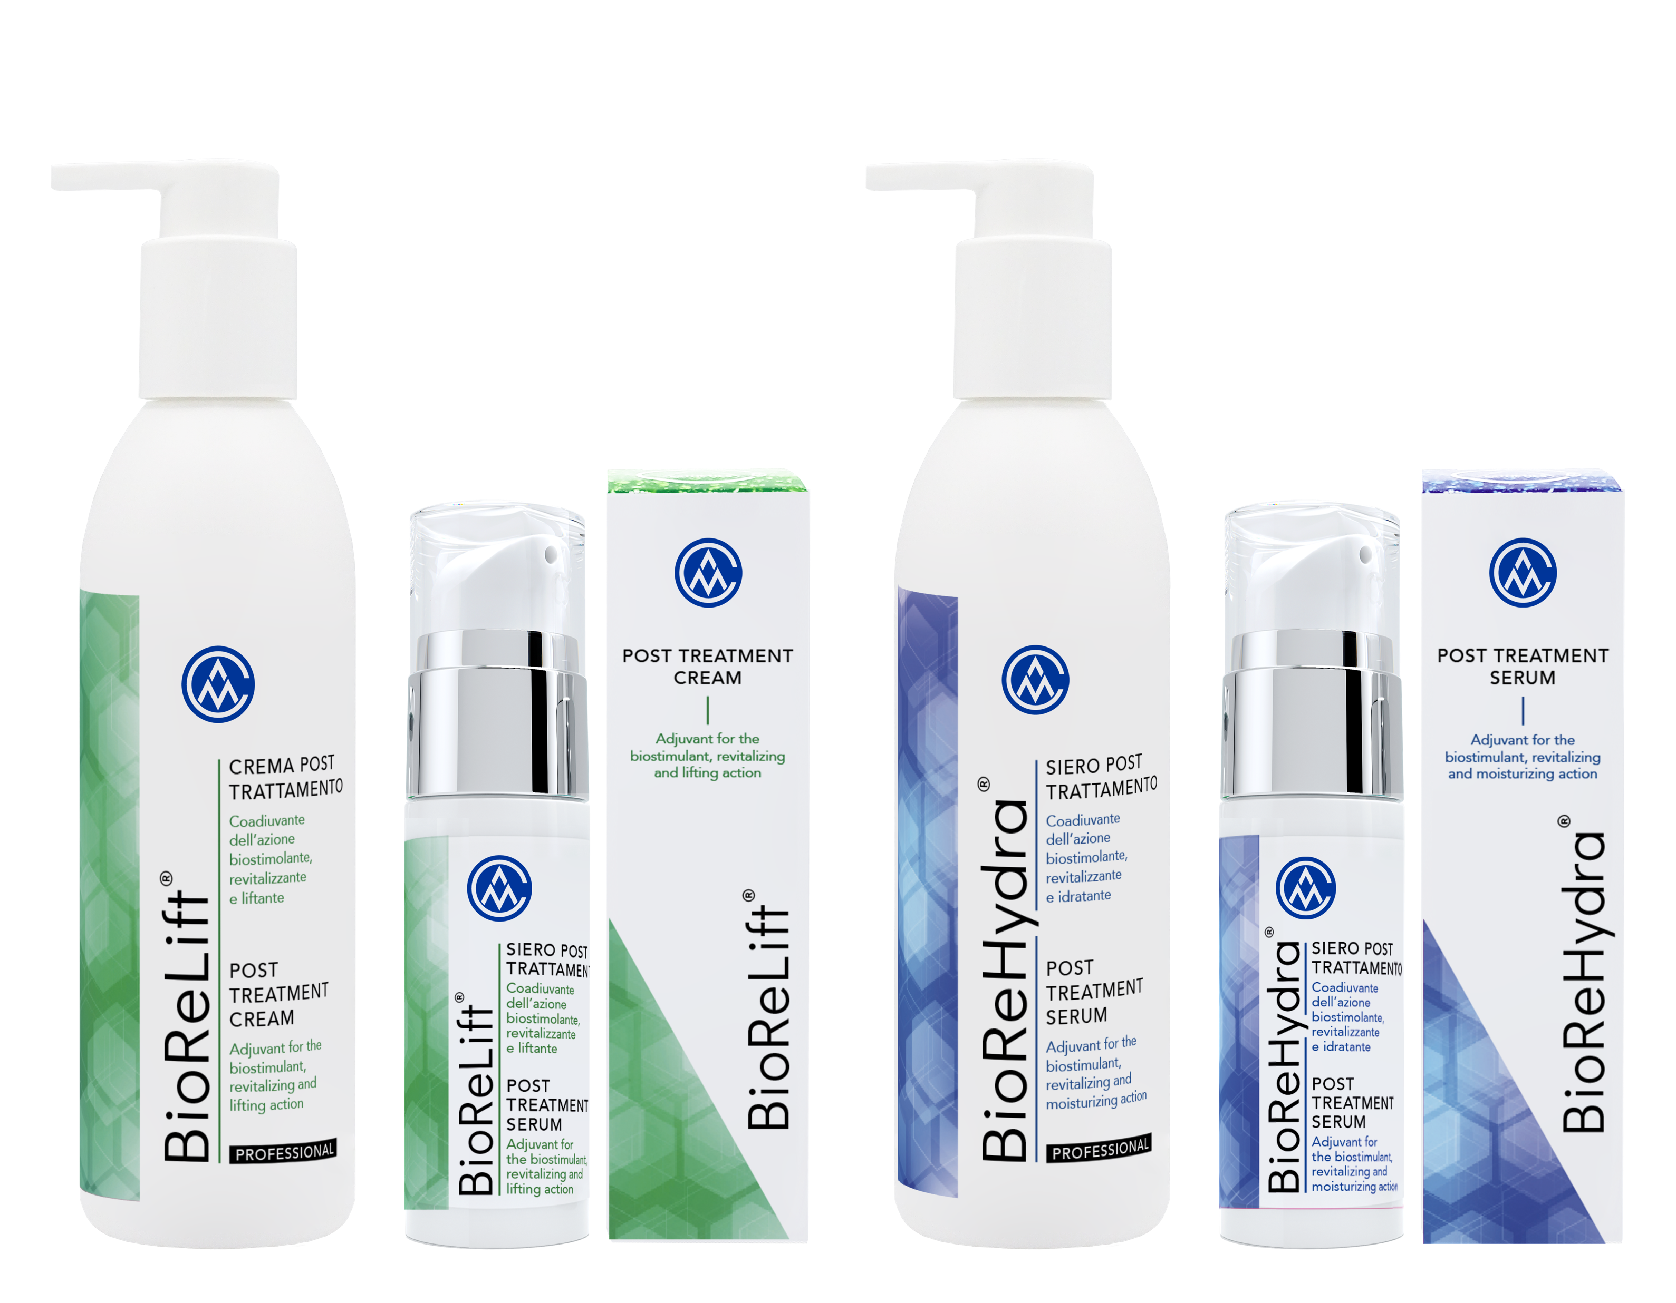

POST TREATMENT CARE
We created BioReHydra® and BioReLift®
to improve the results obtained during and after the BioRePeelCl₃® protocol

Slide 14
It is a post treatment serum, a fast-absorbing hydrogel with light texture.
It donates a fresh skin feel, with moisturizing and lifting effect from the first application.
The formulation has over 15 active ingredients such as:
3 Oceans’ extracts:
- Atlantic Ocean
- Pacific Ocean
- Indian Ocean
Micronized Hyaluronic Acid
Vitamins
GABA
Amino acids

Slide 15
It is a post-treatment cream, presented as a soft, easily absorbed emulsion.
With a silky texture, it donates an enveloping skin feel from the first use.
The formulation has over 20 active ingredients such as:
Micronized Hyaluronic Acid
4 Biomimetic Peptides
Argan & Almond oils
Colloidal Platinum
Shea butter
Vitamins
Bisabolol
Amino acids

Slide 16

BioReHydra®
and BioReLift ®,
as BioRePeelCl₃®,
can be used for:
WHOLE BODY
ALL AGES
ALL SKIN TYPES
ALL SEASONS

Slide 17
BioReHydra® and BioReLift®,
2 sizes for 2 main needs:
In the clinic
At home
Specific for the physician to offer a synergistic post-treatment to the BioRePeelCl₃® protocol and to improve the excellent results obtained during the outpatient treatment.
For the patient to have a specifically-developed home treatment, which enhances the results and benefits of the BioRePeelCl₃® treatment between one session and another.
When?
When?
Immediately after BioRePeelCl₃® treatment
Immediately after radiofrequency treatment
Immediately after laser and photostimulation treatment
In the morning or evening
during BioRePeelCl₃® protocol
In the morning or evening after BioRePeelCl₃® treatment ends
As coadjuvants for other aesthetic procedures
200 mL
30 mL

Slide 18
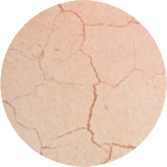

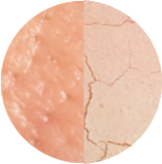
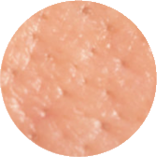
How to use at home?
+
Dry skin
MORNING
EVENING
Normal or
combination skin
+
MORNING
EVENING
+
Oily skin
MORNING
EVENING

Slide 19
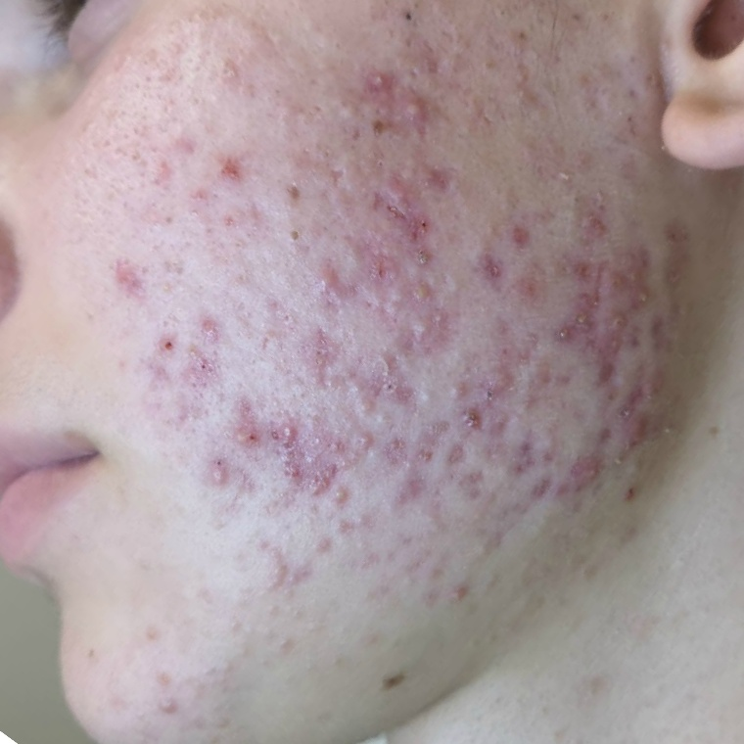
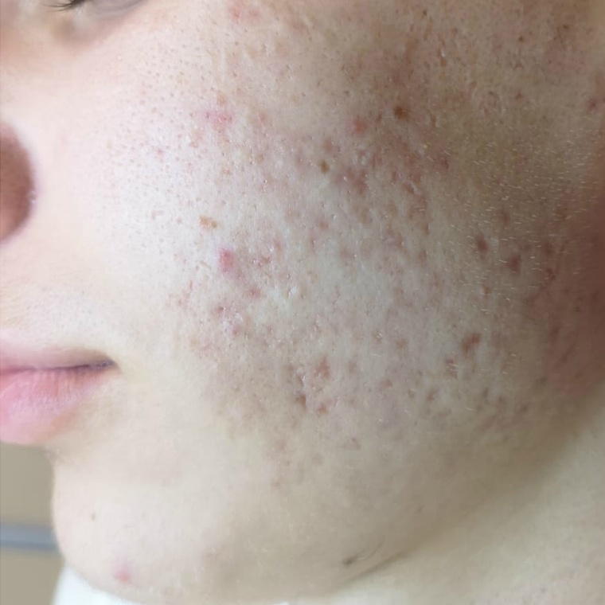
CLINICAL CASES
BEFORE
AFTER

Slide 20
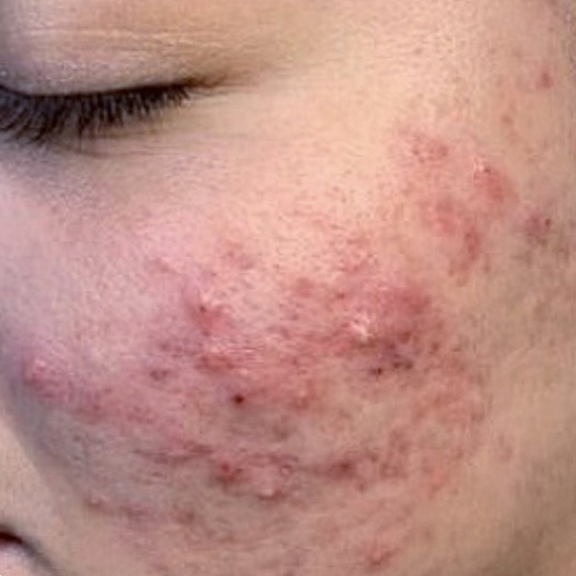
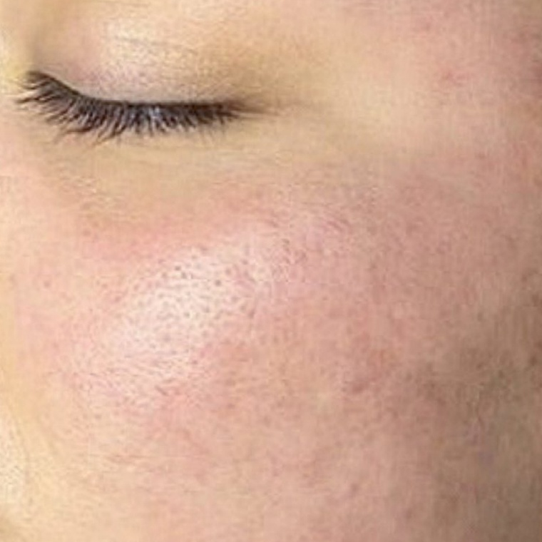
CLINICAL CASES
BEFORE
AFTER

Slide 21
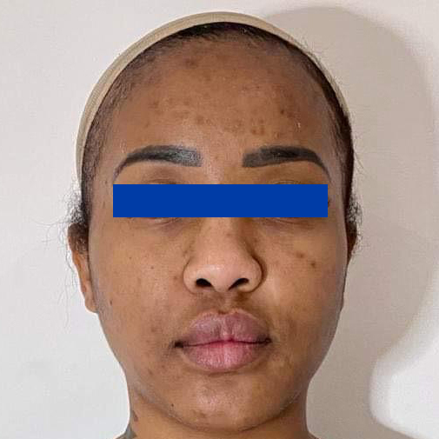
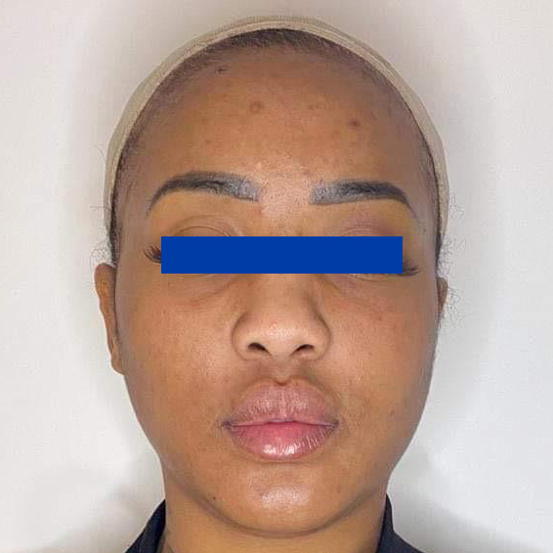
CLINICAL CASES
BEFORE
AFTER

Slide 22
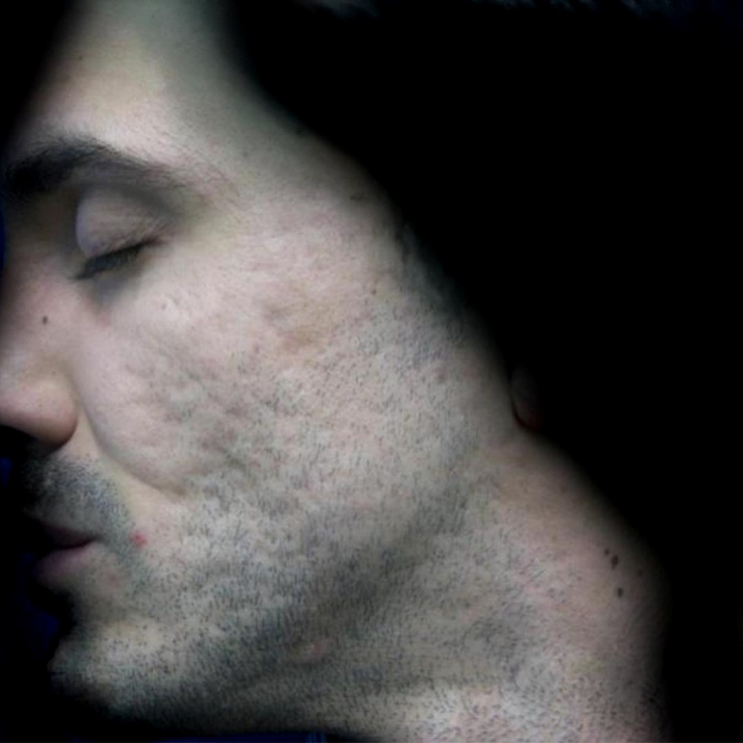
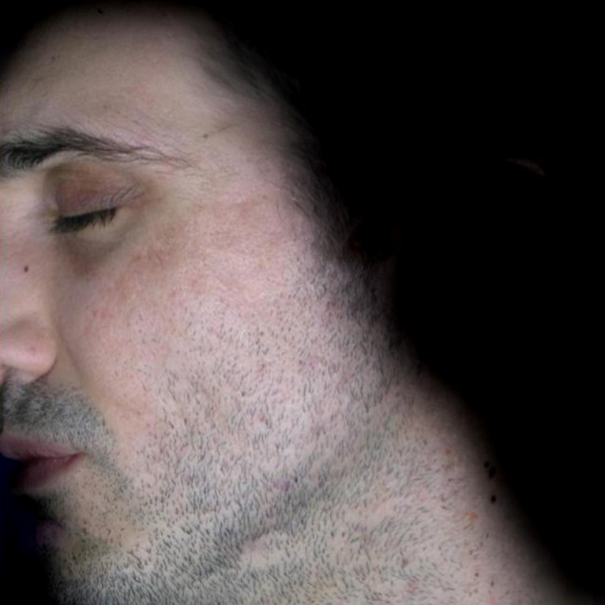
CLINICAL CASES
BEFORE
AFTER

Slide 23
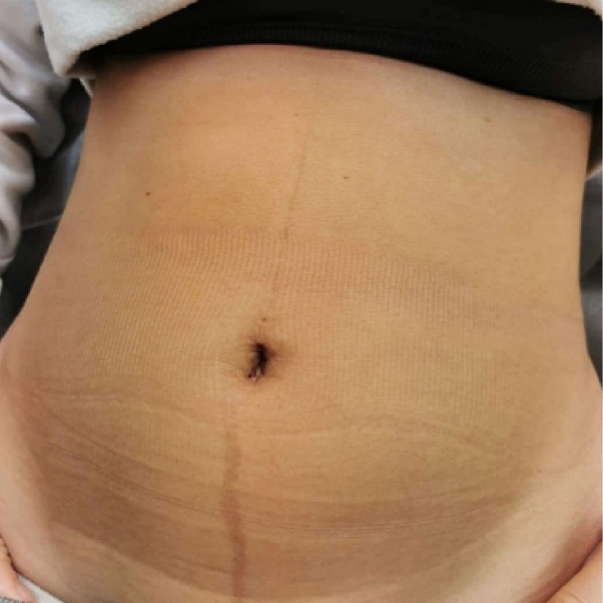
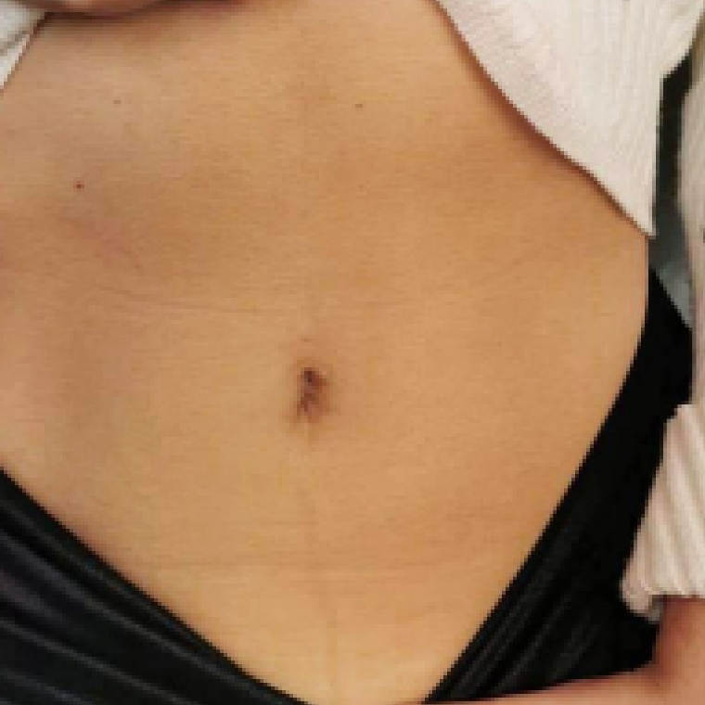
CLINICAL CASES
BEFORE
AFTER

Slide 24
WARNINGS
Avoid contact with eyes, mucous membranes and nails.
In case of accidental contact, rinse with plenty of water or
eye washer.
Avoid the combination with retinol. retinoids (i.e.: isotretinoin) and derivatives. Usage should be stopped one month before
for topical application, three months for oral formulations

