Slide 2
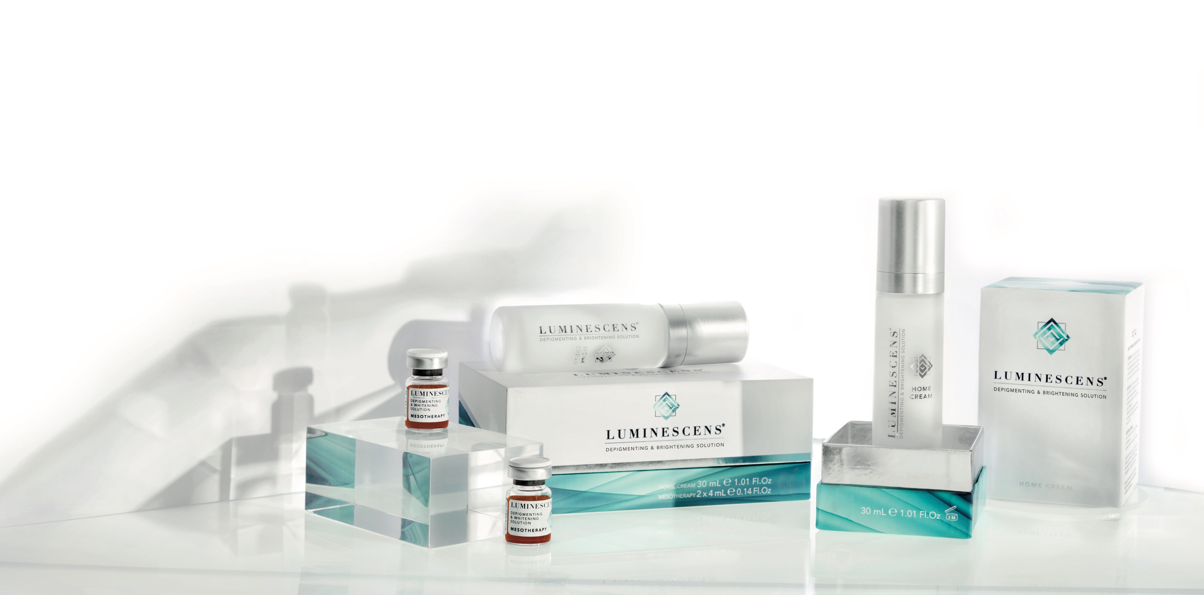


Innovation, safety, efficiency and comfort

Slide 3
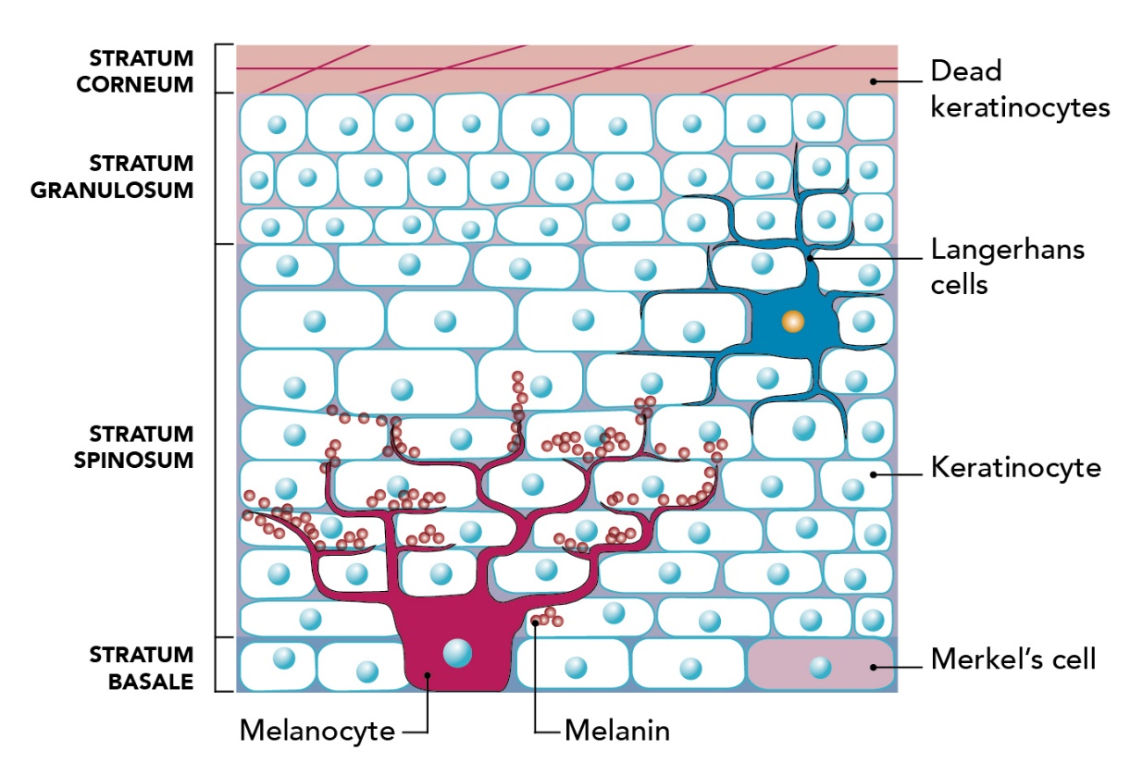
MELANOGENESIS
HYPERPIGMENTATION & SKIN SPOTS
Hyperpigmentation is due to increased melanin production and deposition and is manifested as dark spots on the skin; especially on the face, hands, and other parts of the body often exposed to the sun and difficult to hide.
Hyperpigmentation is caused by an increase of melanin in the basal and suprabasal layers of the epidermis, and it is associated with a normal or high number of melanocytes. It can be caused by various mechanisms, such as melanin transfer from the epidermis to the dermis, and its accumulation within melanophages (relating to pigmentary incontinence). It’s commonly seen in inflammatory skin diseases affecting the basal layer and/or junction dermo-epidermal layer.
The main causes of these disorders are ultraviolet light, chronic inflammation, mechanical irritation of the skin, and an anomalous release of the hormone α-MSH, which stimulates melanocytes.
Intrinsic and extrinsic regulation of human skin melanogenesis and Pigmentation C. Serre, V. Busuttil and J.-M. Botto Global Skin Research Center, Ashland, 655, route du Pin Montard, Sophia Antipolis 06904, France

Slide 4
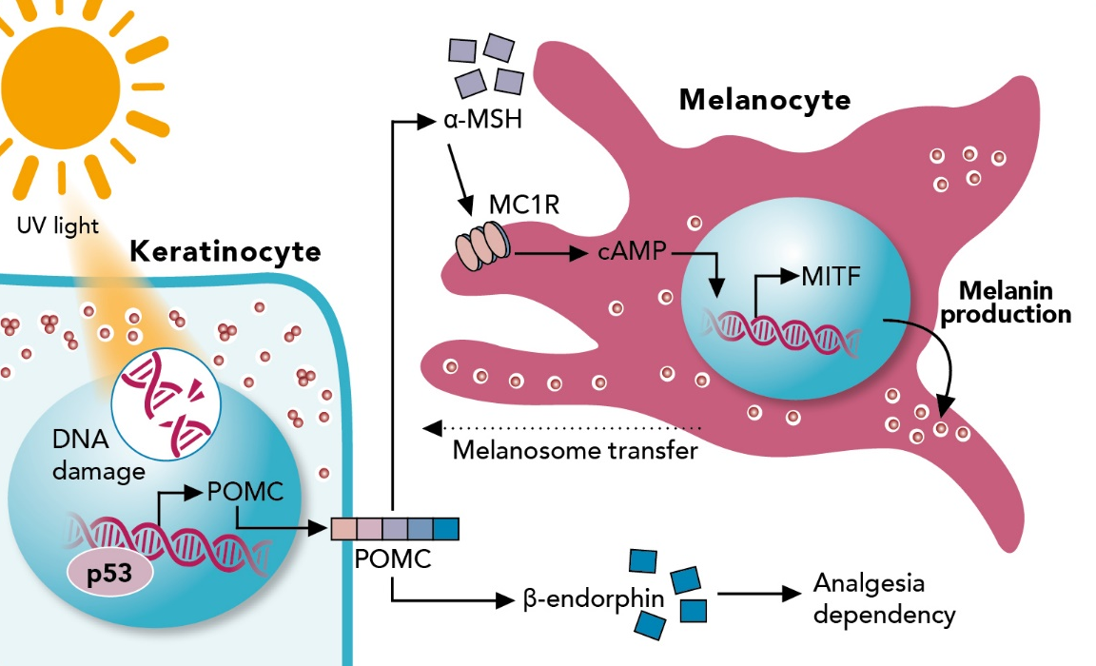
MELANOGENESIS
MELANIN BIOSYNTHESIS
Melanin synthesis in the skin is carried out by specific cells present among the basal cells of the epidermis called melanocytes.
These cells, through chemical signals, communicate with the neighboring keratinocytes, creating an epidermal-melanin unit that is responsible for melanogenesis.
Melanocytes produce melanin in particular structures, called melanosomes.
Thanks to an active movement system mediated by the transport proteins Rab (monomeric GTPases), the melanosome manages to reach the terminal portion of melanocyte dendrites and anchor itself to the cell membrane ready to be transferred to the corneocytes.

Slide 5
MELANOGENESIS
MELANIN BIOSYNTHESIS
The passage of melanosomes from melanocyte to corneocyte is another active step regulated by PAR2 receptors, activated by the action of a protease, trypsin.
The production of melanin has protective functions from solar damage, therefore its synthesis is activated by biological damage processes.
The damage causes the release of a particular hormone called MSH (melanocyte stimulating hormone) which acts on the melanocyte by activating the synthesis of melanosomes storing melanin and their release to epidermal cells, through the stimulation of specific membrane receptor MC1R.

Slide 6
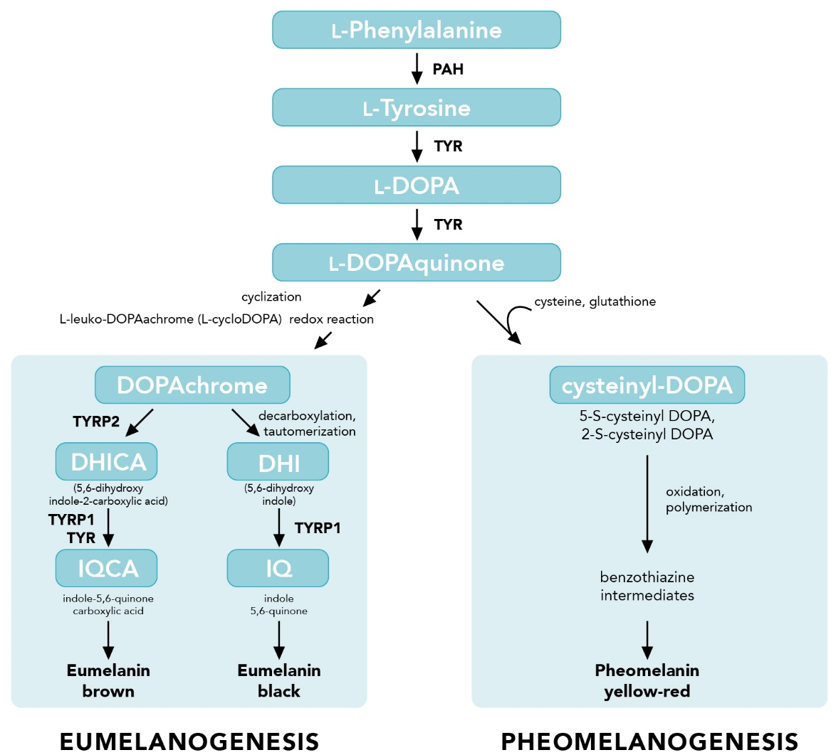
MELANOGENESIS
MELANIN BIOSYNTHESIS
Stimulation of MC1R induces the melanocyte to synthesize melanin as the stimulation of MC1R induces the expression of a transcription factor called MIFT (Microphthalmia-Associated Transcription Factor). This allows the expression of the genes responsible for the synthesis of enzymes necessary for the transformation of tyrosine into melanin.
Starting from aminoacid tyrosine, through the activity of tyrosinase enzyme, DOPA is formed. Then, several further conversions follow to form DOPAquinone, Leuko-DOPAchrome, DOPAchrome, 5,6-dihydroxy indole (decarboxylated and/or carboxylated), indole-5,6-quinone(decarboxylated and/or carboxylated). Eventually polymerization of this last product forms eumelanin.
Intrinsic and extrinsic regulation of human skin melanogenesis and Pigmentation C. Serre, V. Busuttil and J.-M. Botto Global Skin Research Center, Ashland, 655, route du Pin Montard, Sophia Antipolis 06904, France

Slide 7
MELANOGENESIS
MELANIN BIOSYNTHESIS
DOPAquinone reacts with cysteine to form cysteinyl DOPA; after oxidation, cysteinyl DOPA undergoes ring closure to yield benzothiazine intermediates that may couple through a peroxidase/H2O2-promoted reaction or tyrosinase-catalyzed oxidation; the multistep process ends with the formation of pheomelanin.
Melanogenic flow is regulated by melanogenic enzymes (tyrosinase, TYRP1, TYRP2), divalent metal cations, activators and inhibitors and other regulatory factors.
Tyrosinase is the rate-limiting enzyme of hydroxylation of tyrosine to L-DOPA while other actors in melanogenesis control the quality and quantity of formed melanin.
Intrinsic and extrinsic regulation of human skin melanogenesis and Pigmentation C. Serre, V. Busuttil and J.-M. Botto Global Skin Research Center, Ashland, 655, route du Pin Montard, Sophia Antipolis 06904, France

Slide 8
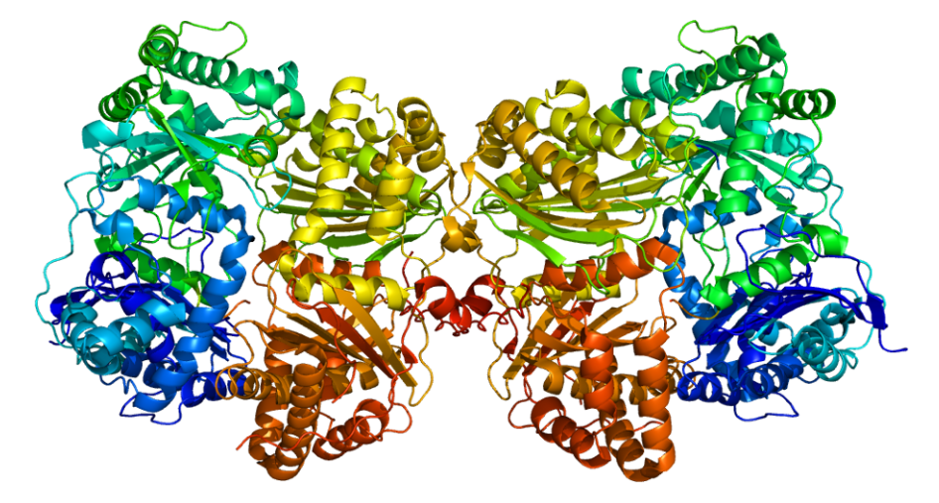
ENZYMES
WHAT IS AN ENZYME?
Enzymes are proteins that act as biological catalysts by accelerating chemical reactions.
The molecules upon which enzymes may act are called substrates and the enzyme converts the substrates into different molecules known as products.

Slide 9
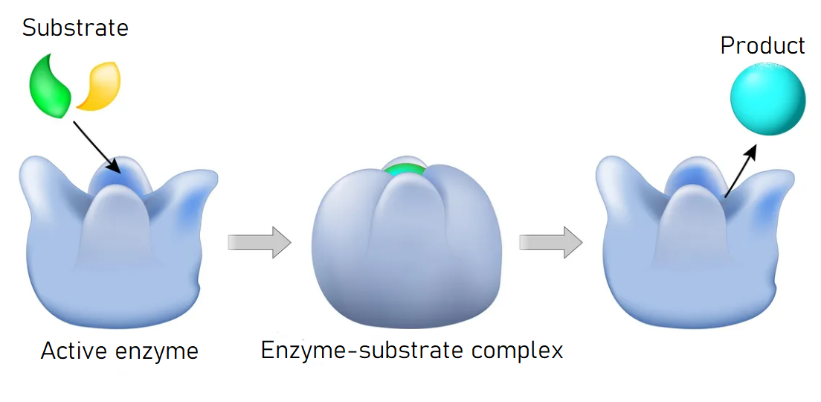
ENZYMES
HOW DO AN ENZYME WORKS?

Slide 10
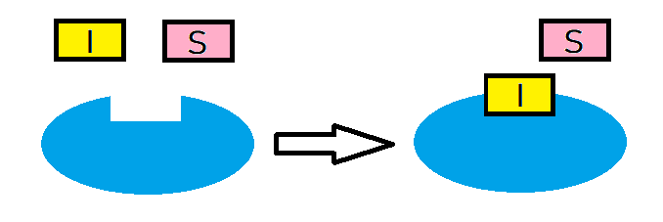

ENZYMES
ENZYMATIC INHIBITION
Competitive
Non-competitive

Slide 11
ENZYMES
COMPETITIVE INHIBITION
MELANOGENIC ENZYME
Tyrosinase inhibitors
- TRANEXAMIC ACID: competitive inhibition of tyrosinase with the substrate Tyr at the binding site.
- ARBUTIN: competitive inhibition of tyrosinase with the substrate L-DOPA at the binding site.

Slide 12
ENZYMES
NON-COMPETITIVE INHIBITION
MELANOGENIC ENZYME
Tyrosinase inhibitors
- TRANEXAMIC ACID: competitive inhibition of tyrosinase with the substrate Tyr at the binding site.
- ARBUTIN: competitive inhibition of tyrosinase with the substrate L-DOPA at the binding site.
- GLABRIDIN: example of non-competitive tyrosinase inhibition.

Slide 13
ENZYMES
SUBSTRATE CHELATING AGENT
MELANOGENIC ENZYME
Tyrosinase inhibitors
- TRANEXAMIC ACID: competitive inhibition of tyrosinase with the substrate Tyr at the binding site.
- ARBUTIN: competitive inhibition of tyrosinase with the substrate L-DOPA at the binding site.
- GLABRIDIN: example of non-competitive tyrosinase inhibition.
- AMINOETHYL PHOSPHINIC ACID: chelates the DOPAchrome preventing further steps of transformation.

Slide 14
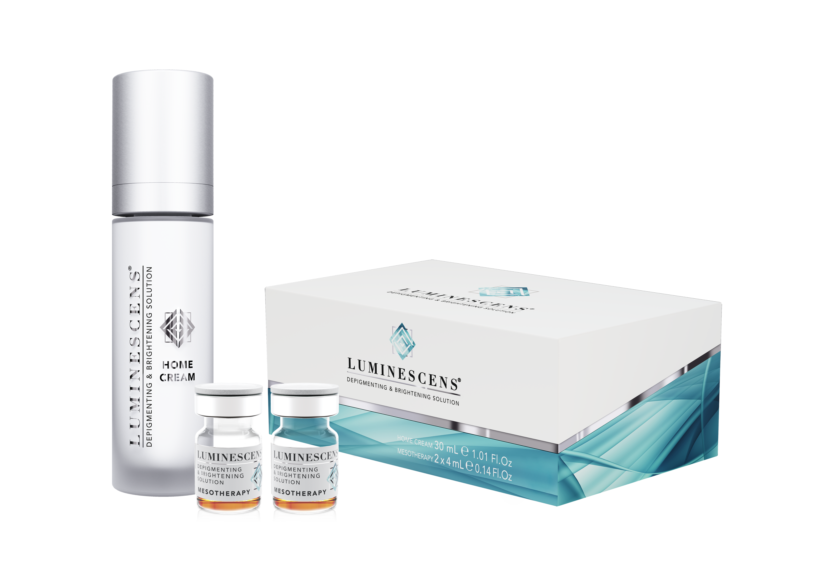

It is a protocol with lightening and depigmenting activity specifically designed for the treatment of SKIN PIGMENTATION of the face and the rest of the body.

Slide 15

The formulation is compatible with
ALL PHOTOTYPES, for oily and dry skin.

Slide 16
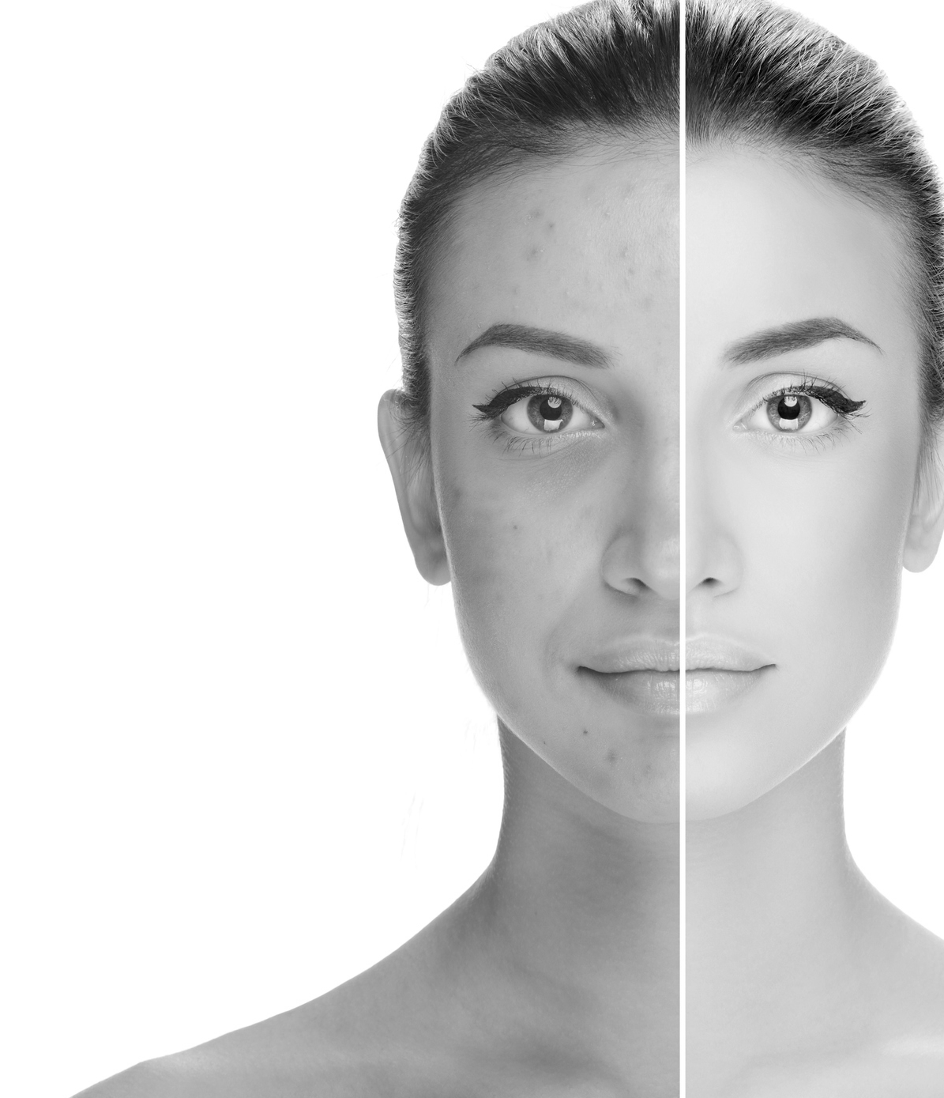
The depigmenting activity is carried out by SPECIFIC ACTIVE INGREDIENTS, assisted by a superficial peeling action that promotes epidermal renewal and favors the delivery to deeper derma layers.

Slide 17
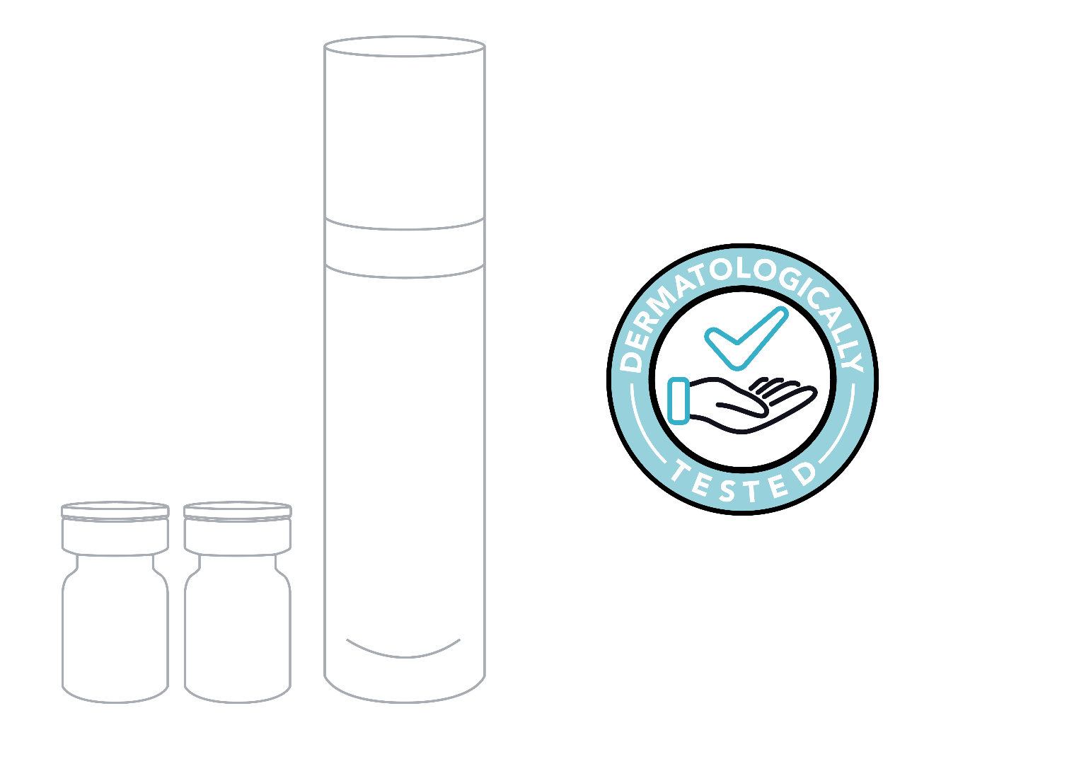
The innovative PROFESSIONAL KIT is the game changer in depigmentation therapy and includes:
2 VIALS - MESOTHERAPY
for 4 outpatient treatments*
1 CREAM
for at-home care
+
*Average estimated. It may vary depending on severity and body parts to be treated

Slide 18
STRENGTHS
MECHANISM OF ACTION
Innovative formulation for outpatient mesotherapy treatment with a pending patent.
Strategies for brighter skin.
No waiting time after treatment and no mask to be applied for 6-12 hours, unlike other products.
Blockade of melanogenic enzymes.
No negative impact on daily life.
Blockade of excess melanin formation.
Cutting-edge formulation, full of active ingredients, made for home treatment with evident results with maximum safety and comfort.
Antioxidant and anti-free radical action.
Increased turnover and hyperpigmentation removal.

Slide 19
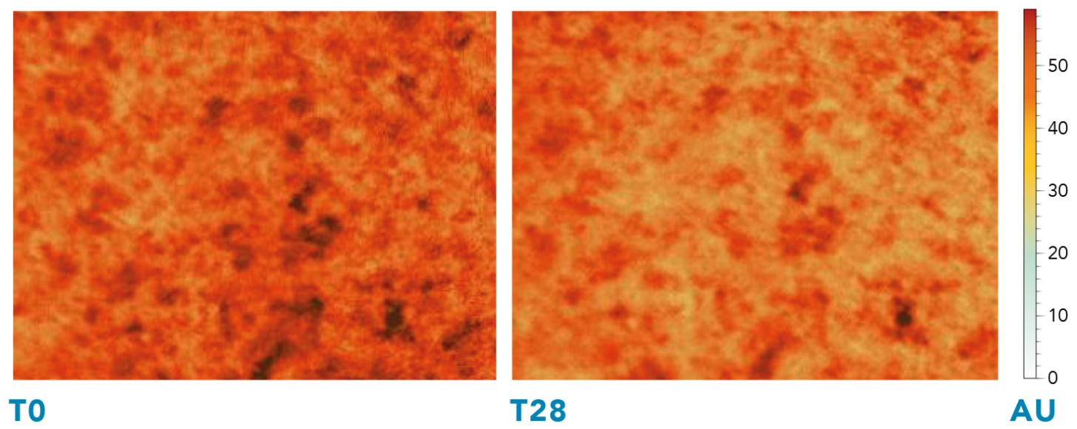
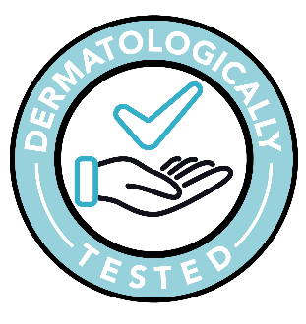
CLINICALLY TESTED RESULTS
Scientifically proven reduction of stains and dermatologically tested.
Scientifically proven reduction of stains and dermatologically tested.
Study of the effect and cosmetic properties of a product through evaluations and instrumental analysis performed by professionals under medical supervision and consumer self-assessments.
Images detected and analyzed with MIRAVEX ANTERA 3D ®
CMed Aesthetics S.p.A. Report 213E30F-1 Bio Basic Europe s.r.l. in collaboration with University of Pavia Department of Biology and Biotechnology “L. Spallanzani”.
Studies carried out at CDC Dermo-Clinical Research Insitute.

Slide 20
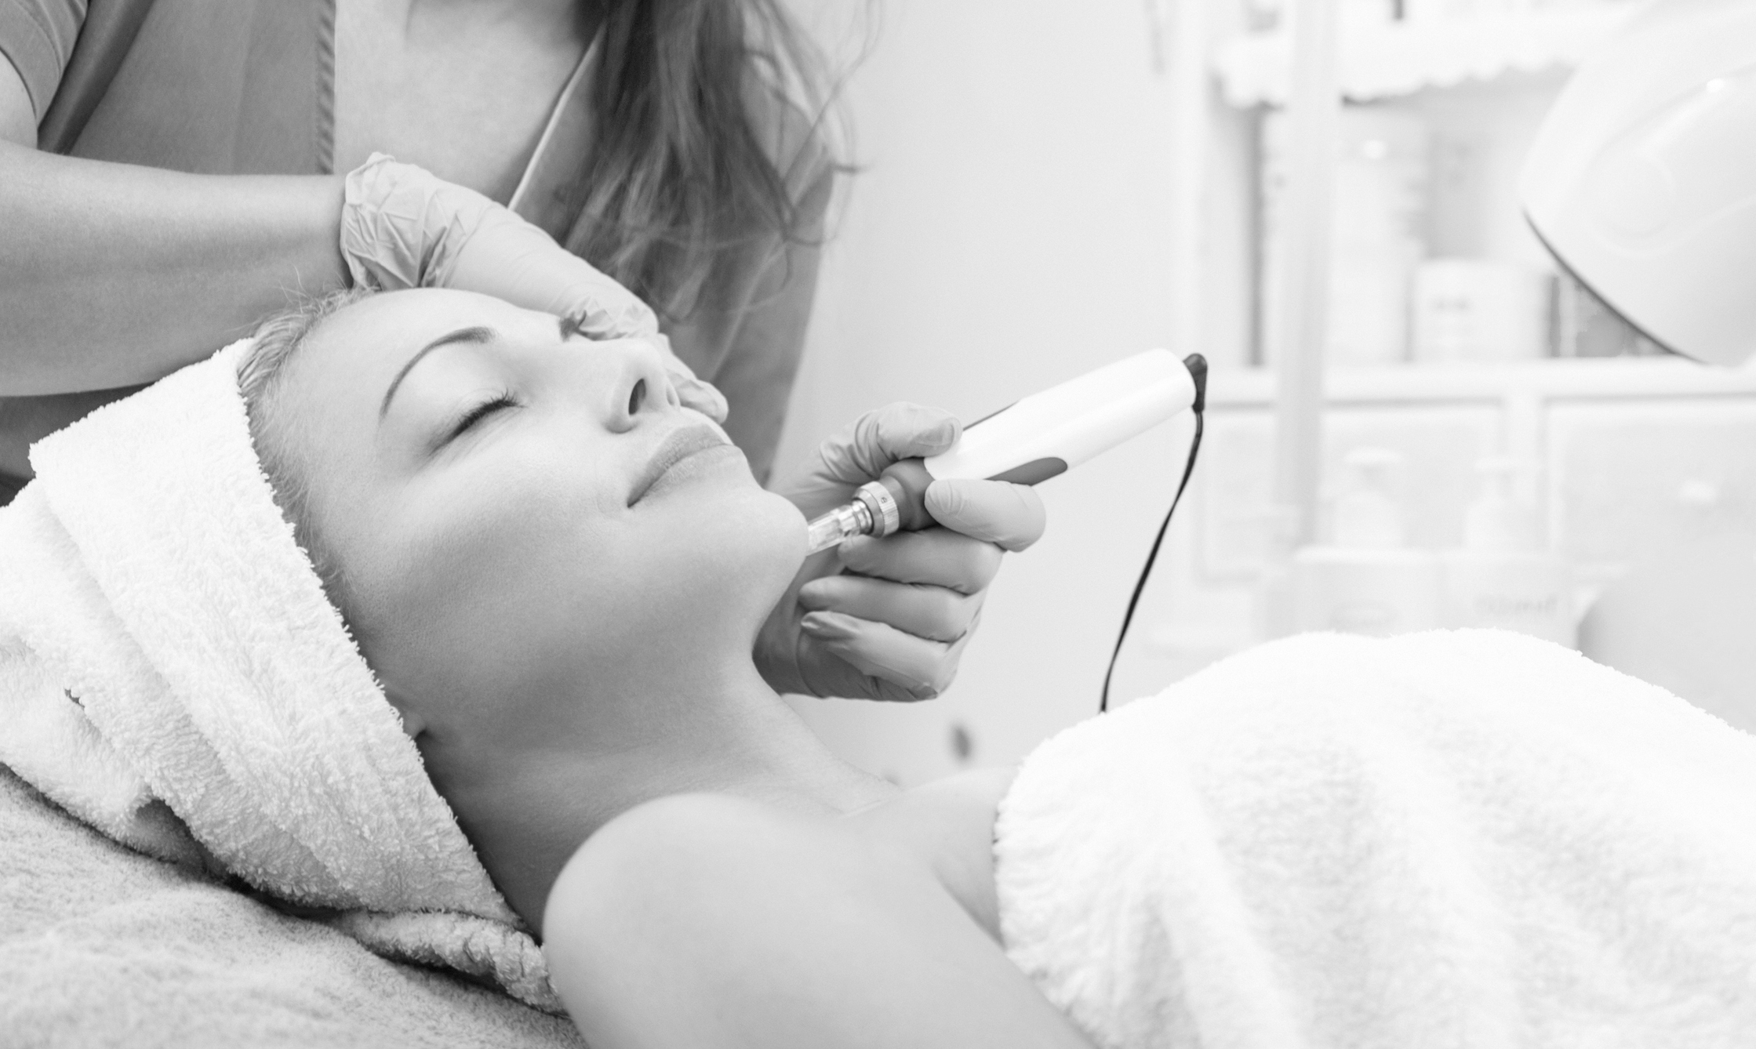
95% OF PATIENTS
said that the treatment reduces skin spots.
gave a positive opinion to the treatment.
said that the mesotherapeutic treatment is pleasant and does not create discomfort on the skin.
said that the home product is comfortable.

Slide 21


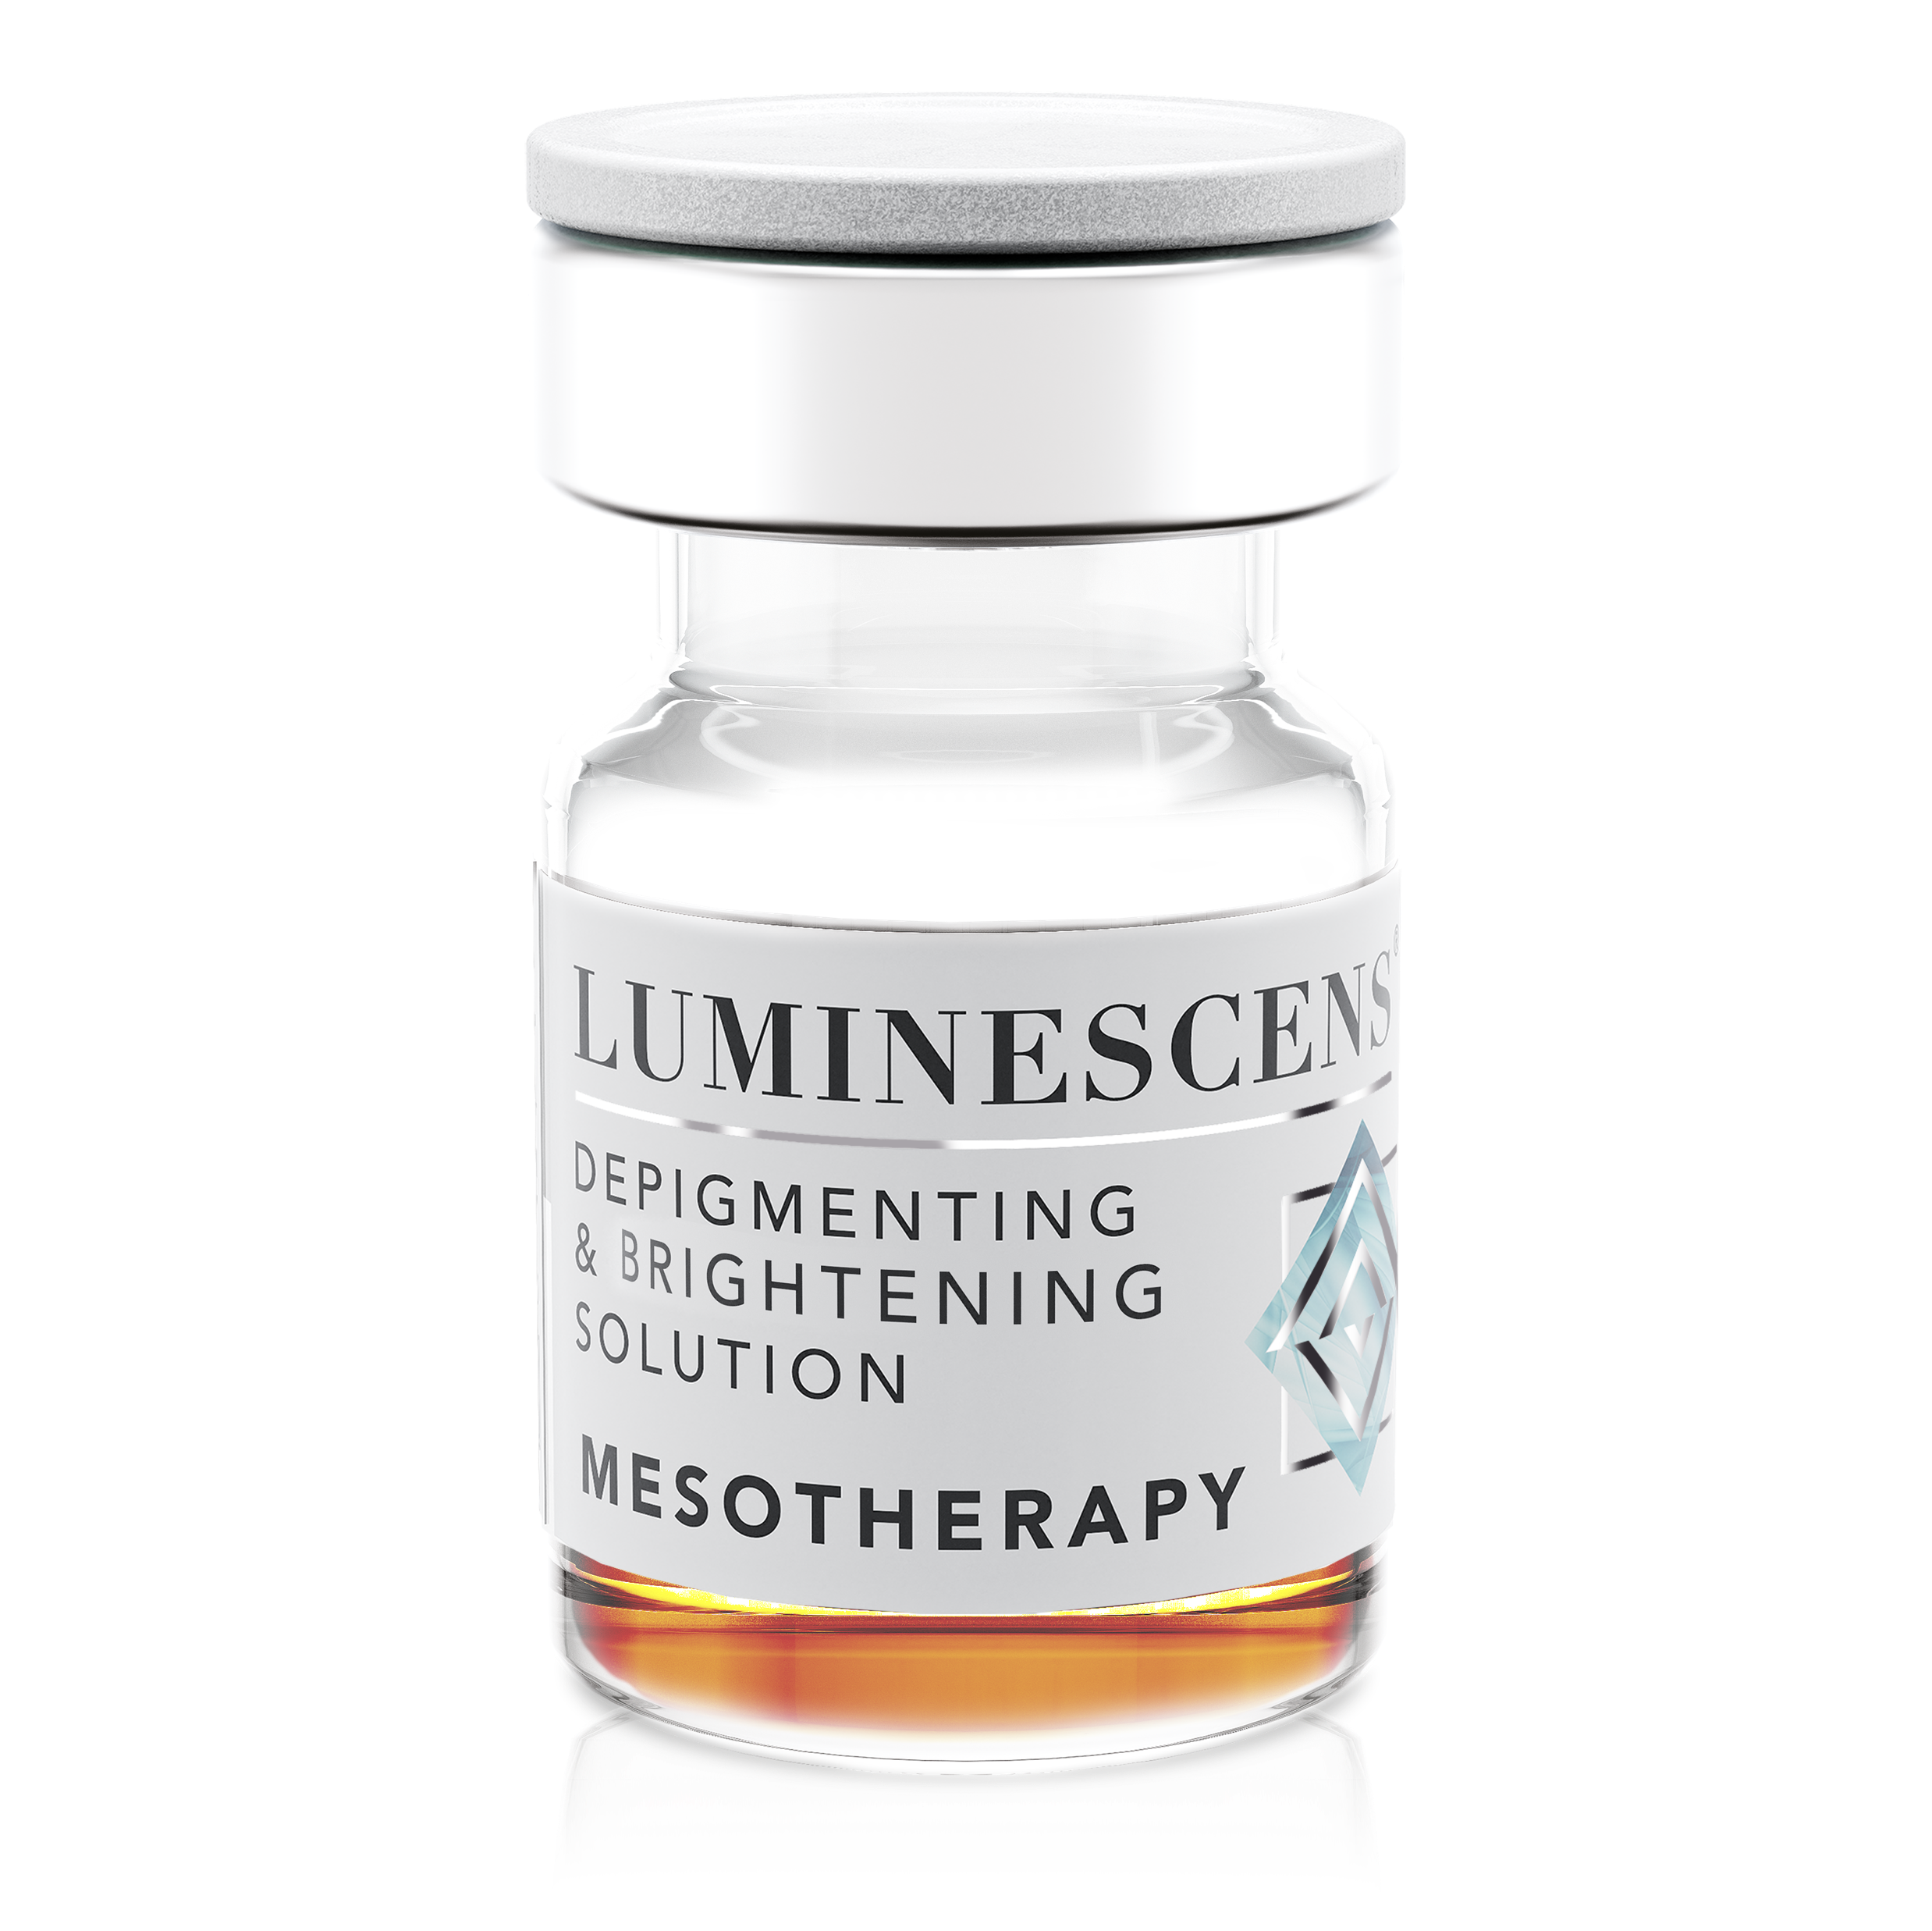
MESO Patented formula
MELANOGENIC ENZYME
BLOCKERS
Tyrosinase inhibitors
- TRANEXAMIC ACID
is a derivative of an essential amino acid, lysine.
It has several mechanism of actions:
-Anti-plasmin activity. Plasmin is responsible for the increase of MSH levels, a melanocyte-stimulating hormone. Moreover, UV light improves the interaction of plasmin with keratinocytes and melanocytes and the release of some mediators, which in turn stimulate the activity of tyrosinase and the formation of melanin. The blocking of plasmin allows for preventing the entire cascade of melanin production.
Competitive inhibition of tyrosinase with its substrate tyrosin.

Slide 22
MESO Patented formula
MELANOGENIC ENZYME
BLOCKERS
Tyrosinase inhibitors
- TRANEXAMIC ACID
- AMINOETHYL PHOSPHINIC ACID
stabilizes DOPAchrome and prevents the further steps of formation of DHI (dihydroxyindole) or its acid form DHICA. It is also a chelating agent: it binds to metal compounds and prevents their fundamental involvement in the melanin cascade regulation. It has an action on the microcirculation by improving epidermal metabolism.

Slide 23
MESO Patented formula
MELANOGENIC ENZYME
BLOCKERS
Tyrosinase inhibitors
- TRANEXAMIC ACID
- AMINOETHYL PHOSPHINIC ACID
- ARBUTIN
is a glycoside that competes with DOPA at its receptor site of tyrosinase enzyme, acting as a substrate. It has good antioxidant capabilities as well, helping to reduce the amount of free radicals generated by UV rays.

Slide 24
MESO Patented formula
MELANOGENIC ENZYME
BLOCKERS
Tyrosinase inhibitors
- TRANEXAMIC ACID
- AMINOETHYL PHOSPHINIC ACID
- ARBUTIN
- OXOTHIAZOLIDINECARBOXYLIC ACID
- VITIS VINIFERA LEAF EXTRACT
- ROSMARINUS OFFICINALIS EXTRACT
- MELISSA OFFICINALIS LEAF EXTRACT
- SALVIA OFFICINALIS LEAF EXTRACT
- CAMELLIA SINENSIS LEAF EXTRACT
- BETULA PUBESCENS TWIG EXTRACT
- RUTIN
- OLIGOPEPTIDE-34

Slide 25
MESO Patented formula
MELANOGENIC ENZYME
BLOCKERS
MELANIN FORMATION &
TRANSPORT BLOCKERS
Tyrosinase inhibitors
Copper chelators and MC1R enzyme inhibitors
- TRANEXAMIC ACID
- ELLAGIC ACID
- AMINOETHYL PHOSPHINIC ACID
- SODIUM PHYTATE
- ARBUTIN
- ACETYL TETRAPEPTIDE-2
- OXOTHIAZOLIDINECARBOXYLIC ACID
- VITIS VINIFERA LEAF EXTRACT
- ROSMARINUS OFFICINALIS EXTRACT
- MELISSA OFFICINALIS LEAF EXTRACT
- SALVIA OFFICINALIS LEAF EXTRACT
- CAMELLIA SINENSIS LEAF EXTRACT
- BETULA PUBESCENS TWIG EXTRACT
- RUTIN
- OLIGOPEPTIDE-34

Slide 26
MESO Patented formula
MELANOGENIC ENZYME
BLOCKERS
MELANIN FORMATION &
TRANSPORT BLOCKERS
Tyrosinase inhibitors
Copper chelators and MC1R enzyme inhibitors
- TRANEXAMIC ACID
- ELLAGIC ACID
- AMINOETHYL PHOSPHINIC ACID
- SODIUM PHYTATE
- ARBUTIN
- ACETYL TETRAPEPTIDE-2
- OXOTHIAZOLIDINECARBOXYLIC ACID
INCREASE IN CELL TURNOVER
- VITIS VINIFERA LEAF EXTRACT
Removal of pre-existing melanin
- ROSMARINUS OFFICINALIS EXTRACT
- SALICYLIC ACID
- MELISSA OFFICINALIS LEAF EXTRACT
- SALVIA OFFICINALIS LEAF EXTRACT
- CAMELLIA SINENSIS LEAF EXTRACT
- BETULA PUBESCENS TWIG EXTRACT
- RUTIN
- OLIGOPEPTIDE-34

Slide 27
MESO Patented formula
MELANOGENIC ENZYME
BLOCKERS
MELANIN FORMATION &
TRANSPORT BLOCKERS
Tyrosinase inhibitors
Copper chelators and MC1R enzyme inhibitors
- TRANEXAMIC ACID
- ELLAGIC ACID
- AMINOETHYL PHOSPHINIC ACID
- SODIUM PHYTATE
- ARBUTIN
- ACETYL TETRAPEPTIDE-2
- OXOTHIAZOLIDINECARBOXYLIC ACID
INCREASE IN CELL TURNOVER
- VITIS VINIFERA LEAF EXTRACT
Removal of pre-existing melanin
- ROSMARINUS OFFICINALIS EXTRACT
- SALICYLIC ACID
- MELISSA OFFICINALIS LEAF EXTRACT
ANTIOXIDANTS &
DERMO-NORMALIZING AGENTS
- SALVIA OFFICINALIS LEAF EXTRACT
- CAMELLIA SINENSIS LEAF EXTRACT
Action against pigment-increasing free radicals
- BETULA PUBESCENS TWIG EXTRACT
- GLUTATHION
- RUTIN
- POTASSIUM AZELOYL DIGLYCINATE
- OLIGOPEPTIDE-34
- SODIUM DNA
- HYALURONIC ACID

Slide 28
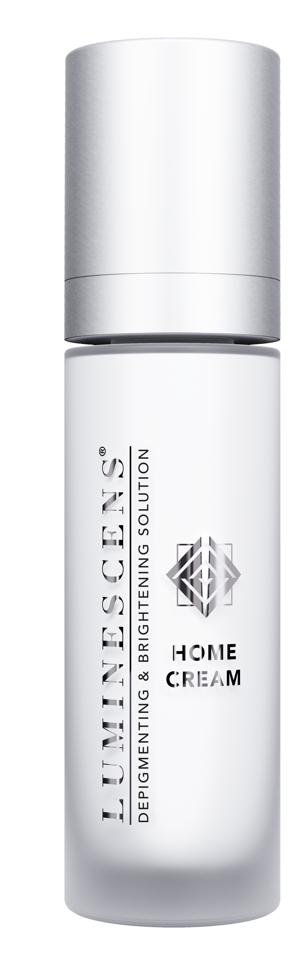

HOME CREAM ingredients
MELANOGENIC ENZYME BLOCKERS
Tyrosinase inhibitors
- TRANEXAMIC ACID
is a derivative of an essential amino acid, lysine.
It has several mechanism of actions:
Anti-plasmin activity. Plasmin is responsible for the increase of MSH level, melanocyte stimulating hormone. Moreover, UV light improves the interaction of plasmin with keratinocytes and melanocytes and the release of some mediators which in turn stimulate the activity of tyrosinase and the formation of melanin. The blocking of plasmin allows to prevent the full cascade of melanin production.
Competitive inhibition of tyrosinase with its substrate tyrosin.

Slide 29
HOME CREAM ingredients
MELANOGENIC ENZYME BLOCKERS
Tyrosinase inhibitors
- TRANEXAMIC ACID
- AMINOETHYL PHOSPHINIC ACID
stabilizes DOPAchrome and prevents the further steps of formation of DHI (dihydroxyindole) or its acid form DHICA. It is a chelating agent as well: binds to metal compounds and prevents their fundamental involvement in the melanin cascade regulation. It has an action on the microcirculation by improving epidermal metabolism.

Slide 30
HOME CREAM ingredients
MELANOGENIC ENZYME BLOCKERS
Tyrosinase inhibitors
- TRANEXAMIC ACID
- AMINOETHYL PHOSPHINIC ACID
- ARBUTIN
is a glycoside that competes with DOPA at its receptor site of tyrosinase enzyme, acting as a substrate. It has good antioxidant capabilities as well, helping to reduce the amount of free radicals generated by UV rays.

Slide 31
HOME CREAM ingredients
MELANOGENIC ENZYME BLOCKERS
Tyrosinase inhibitors
- TRANEXAMIC ACID
- AMINOETHYL PHOSPHINIC ACID
- ARBUTIN
- OLIGOPEPTIDE-34

Slide 32
HOME CREAM ingredients
MELANOGENIC ENZYME BLOCKERS
Tyrosinase inhibitors
- TRANEXAMIC ACID
- AMINOETHYL PHOSPHINIC ACID
- ARBUTIN
- OLIGOPEPTIDE-34
- GLABRIDIN
is a natural licorice derivative and an extremely powerful depigmenting agent.
It’s an example of non-competitive tyrosinase inhibition; this means the binding site does not coincide with the substrate binding site (see arbutin or tranexamic acid), but it involves another portion of the enzyme.
Anti-inflammatory effects of glabridin in vitro were also shown by its inhibition of superoxide anion productions and cyclooxygenase activities. These data indicated that glabridin is a unique compound possessing more than one function.

Slide 33
HOME CREAM ingredients
MELANOGENIC ENZYME BLOCKERS
Tyrosinase inhibitors
- TRANEXAMIC ACID
- AMINOETHYL PHOSPHINIC ACID
- ARBUTIN
- OLIGOPEPTIDE-34
- GLABRIDIN
- SILYBUM MARIANUM EXTRACT
- PHENYLETHYL RESORCINOL
- GLYCYRRHETINIC ACID

Slide 34
HOME CREAM ingredients
MELANOGENIC ENZYME BLOCKERS
Tyrosinase inhibitors
- TRANEXAMIC ACID
- AMINOETHYL PHOSPHINIC ACID
- ARBUTIN
- OLIGOPEPTIDE-34
- GLABRIDIN
- SILYBUM MARIANUM EXTRACT
- PHENYLETHYL RESORCINOL
- GLYCYRRHETINIC ACID
INCREASE IN CELL TURNOVER
Removal of pre-existing melanin
- SALICYLIC ACID
- CITRIC ACID
- TARTARIC ACID
- RETINOL

Slide 35
HOME CREAM ingredients
MELANOGENIC ENZYME BLOCKERS
MELANIN FORMATION &
TRANSPORT BLOCKERS
Tyrosinase inhibitors
Copper chelators and MC1R enzyme inhibitors
- TRANEXAMIC ACID
- AMINOETHYL PHOSPHINIC ACID
- NICOTIANA BENTHAMIANA
- ARBUTIN
- HEXAPEPTIDE-40
- OLIGOPEPTIDE-34
- SH-POLYPEPTIDE-76
- ACETYL HEXAPEPTIDE-1
- GLABRIDIN
- PHYTIC ACID
- SILYBUM MARIANUM EXTRACT
- PHENYLETHYL RESORCINOL
- GLYCYRRHETINIC ACID
INCREASE IN CELL TURNOVER
Removal of pre-existing melanin
- SALICYLIC ACID
- CITRIC ACID
- TARTARIC ACID
- RETINOL

Slide 36
HOME CREAM ingredients
MELANOGENIC ENZYME BLOCKERS
MELANIN FORMATION &
TRANSPORT BLOCKERS
Tyrosinase inhibitors
Copper chelators and MC1R enzyme inhibitors
- TRANEXAMIC ACID
- AMINOETHYL PHOSPHINIC ACID
- NICOTIANA BENTHAMIANA
- ARBUTIN
- HEXAPEPTIDE-40
- OLIGOPEPTIDE-34
- SH-POLYPEPTIDE-76
- ACETYL HEXAPEPTIDE-1
- GLABRIDIN
- PHYTIC ACID
- SILYBUM MARIANUM EXTRACT
- PHENYLETHYL RESORCINOL
- GLYCYRRHETINIC ACID
ANTIOXIDANTS &
DERMO-NORMALIZING AGENTS
INCREASE IN CELL TURNOVER
Action against pigment-increasing free radicals
Removal of pre-existing melanin
- HYALURONIC ACID
- SALICYLIC ACID
- PANTHENOL
- CITRIC ACID
- TOCOPHERYL ACETATE
- TARTARIC ACID
- RETINOL

Slide 37
PROTOCOL OF USE
LUMINESCENS® treatment is to be carried out in two stages:
1
In clinic with LUMINESCENS® MESOTHERAPY treatment.
The mesotherapy solution must be used by professionals only in a clinic environment.
The application method is either microneedling, using devices such as a microneedling pen, dermaroller or similar, or electroporation.
Recommended product amount per application is 1 mL per 10 sq/cm body area including intimate areas; 2 mL for face treatment. The amount of the product can be increased to treat more persistent pigmentation.
2
At home with LUMINESCENS® HOME CREAM.
After clinic treatment, patient should follow home care protocol with home cream application as described below.

Slide 38
PROTOCOL OF USE
Day 1 First mesotherapy application in clinic + post treatment home cream.
Day 2-7 Apply the home cream twice a day, preferably morning and evening.
Day 8-13 Apply the home cream massaging until completely absorbed once a day, in the evening.
Day 14 Second mesotherapy application in clinic.
Day 15-28 Apply the home cream massaging until completely absorbed once a day, in the evening.
The treatment protocol is for the exclusive use of a professional who applies it accordingly to the specific needs of the patient and the result to be obtained. It is possible to identify a standard procedure that can be used in cases of skin hyperpigmentation: melasma, chloasma, solar lentigo or as a lightening and illuminating treatment.
For the duration of the treatment it is important to apply an SPF 50+ sunscreen cream and avoid exposure to the sun or UV lamps.
The minimum recommended period for treatment is 28 days, to be repeated for another 28 if necessary and indicated by the doctor.

Slide 39
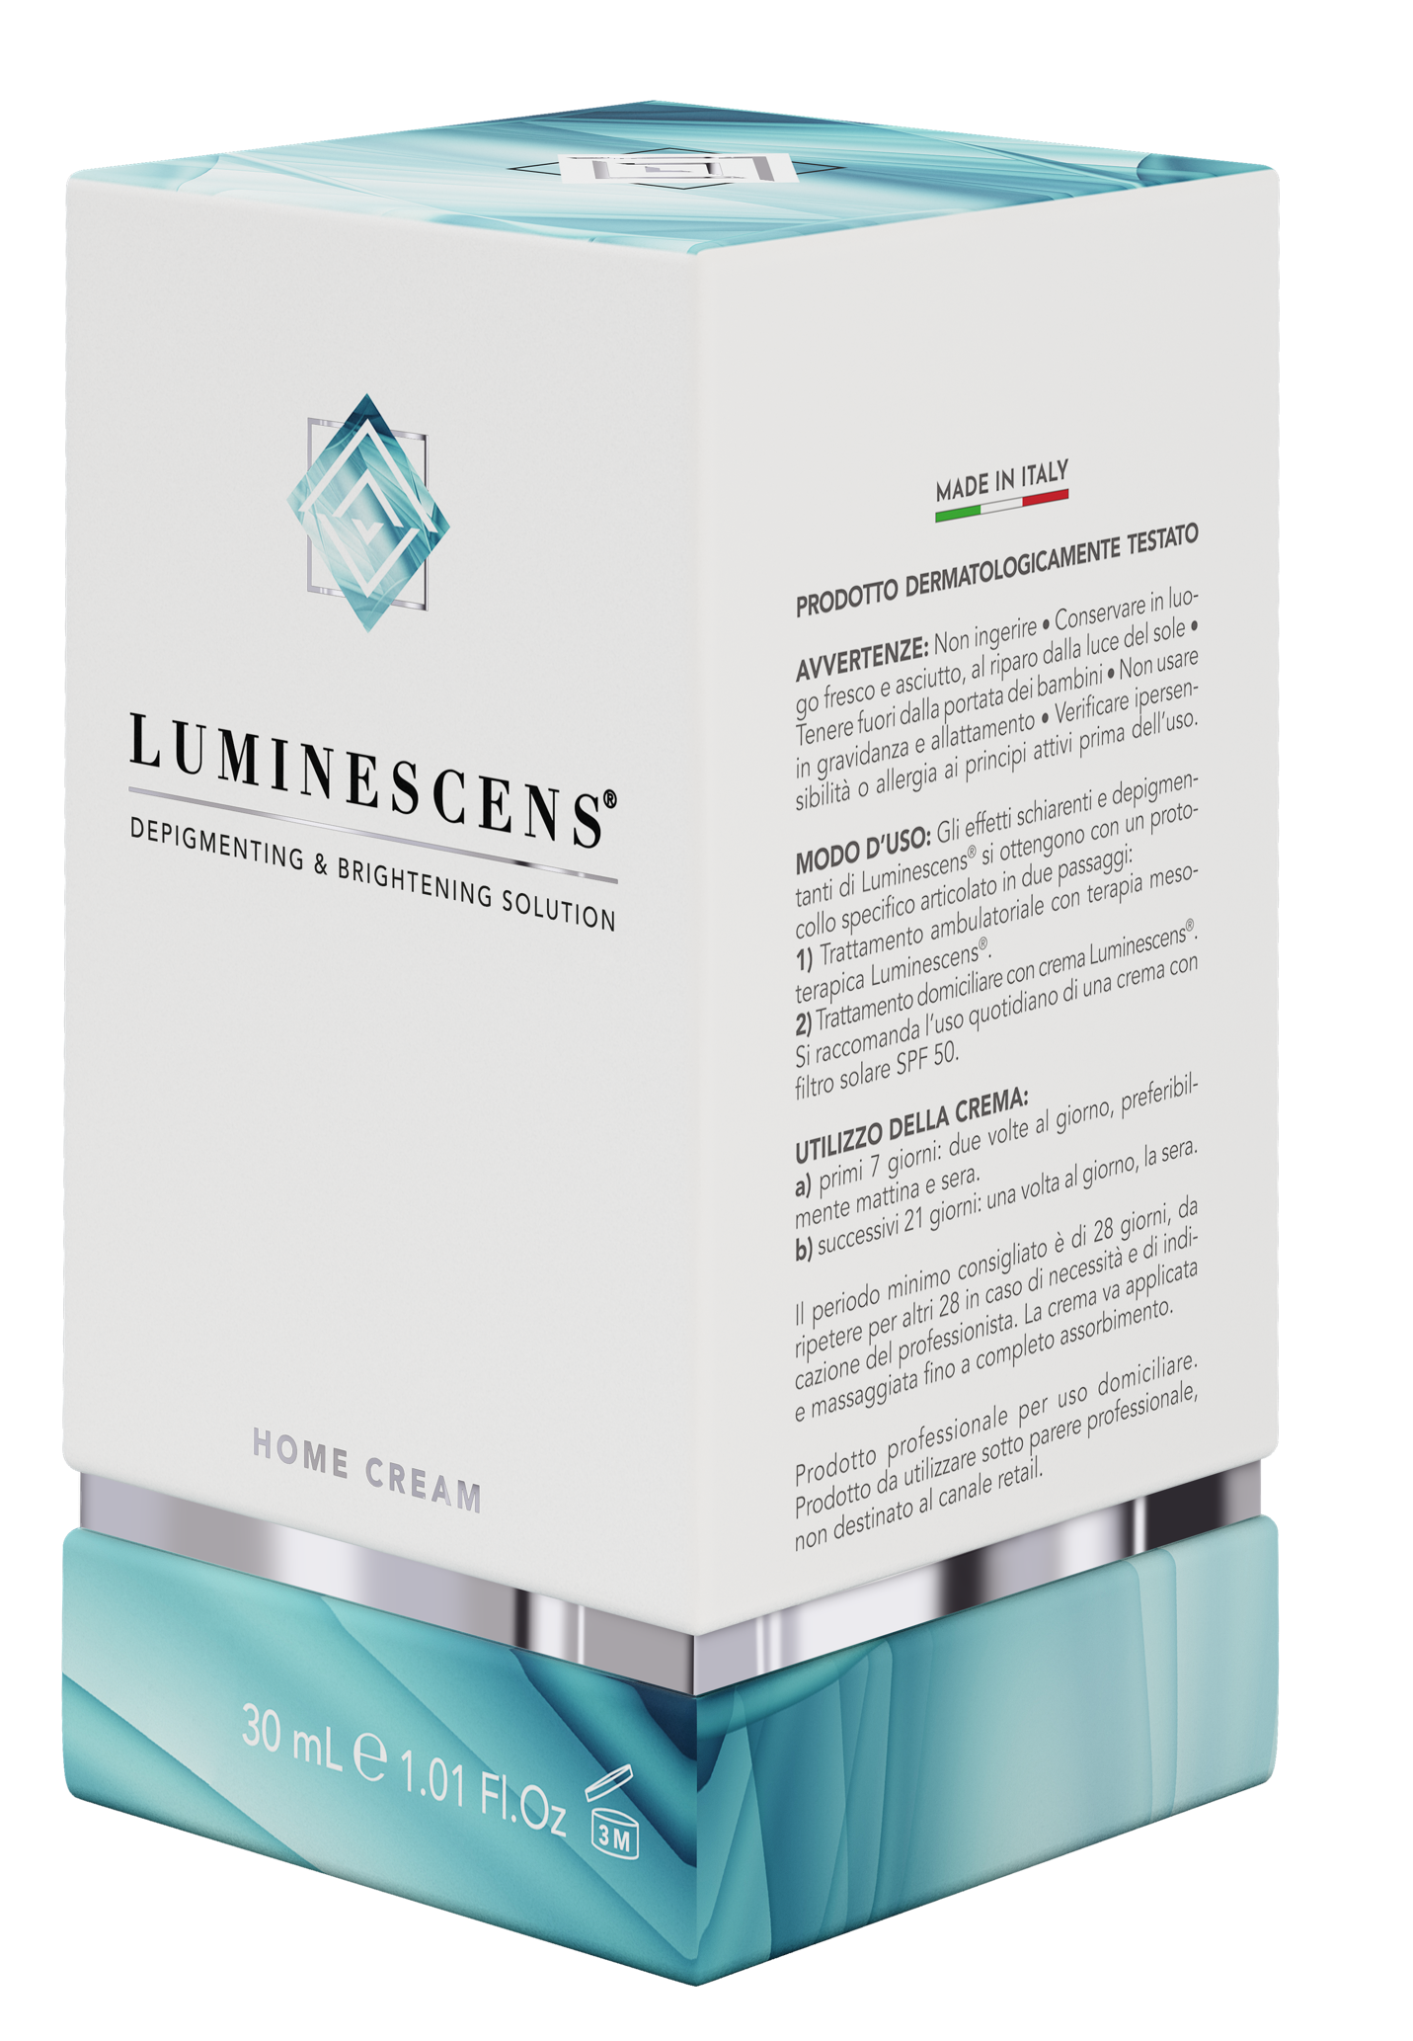
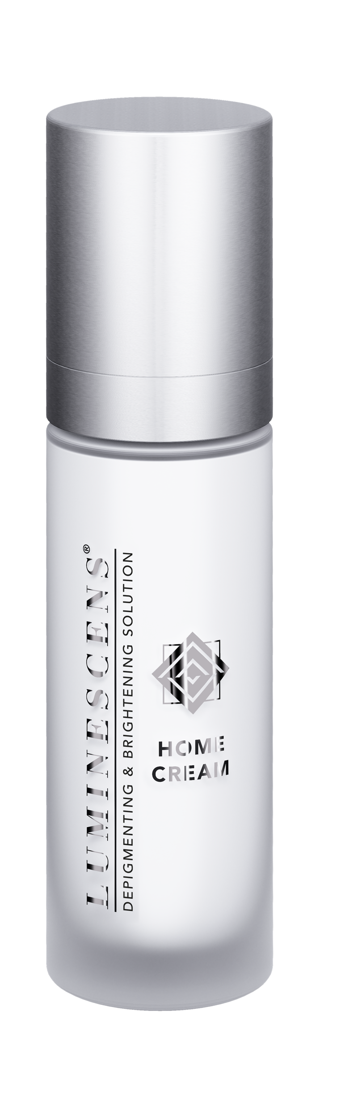
HOME CREAM
This box contains only the depigmenting LUMINESCENS® HOME CREAM 30 mL and is designed to be given directly to the patient to continue the treatment at home.

Slide 40
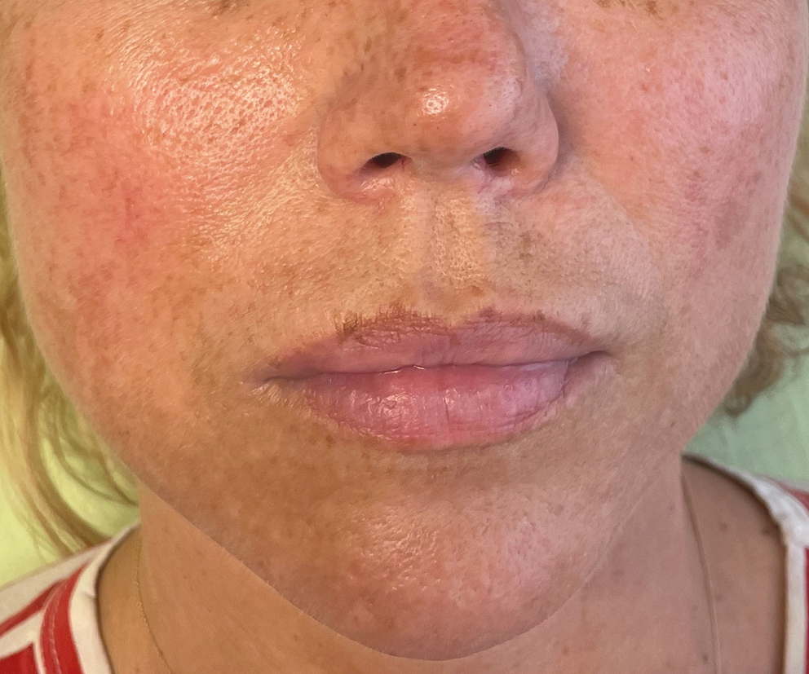
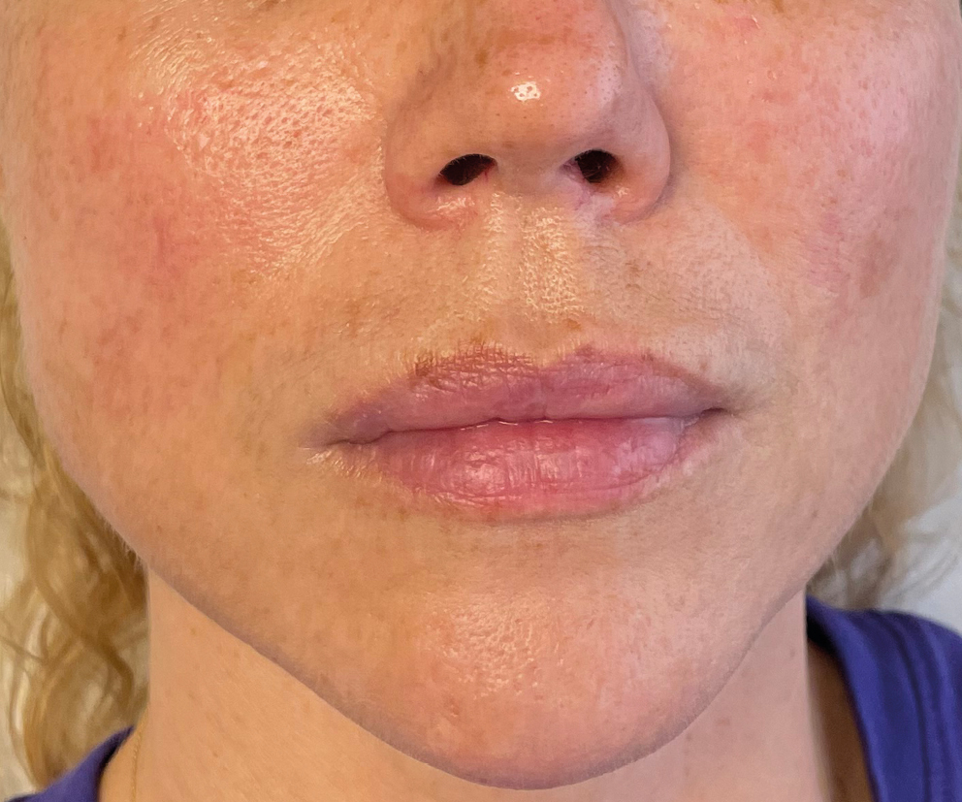
BEFORE AND AFTER RESULTS
GENDER: FEMALE / AGE 43 RESULT AFTER 60 DAYS OF TREATMENT

Slide 41
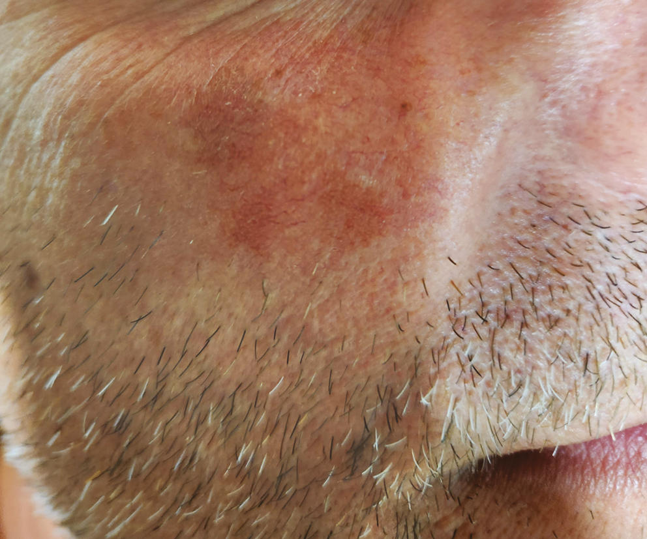
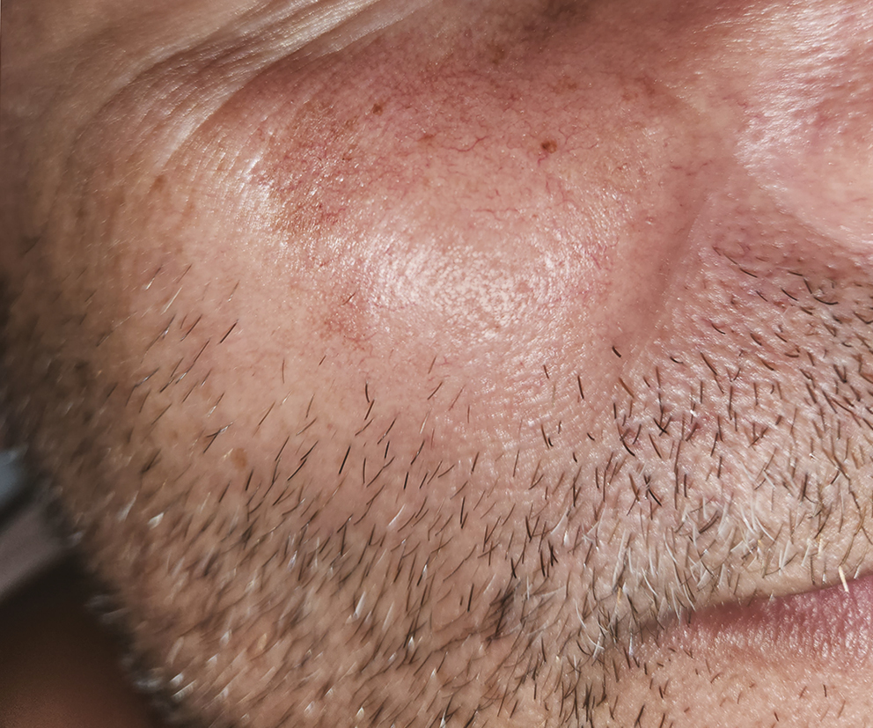
BEFORE AND AFTER RESULTS
GENDER: MALE / AGE 51 RESULT AFTER 30 DAYS OF TREATMENT

Slide 42
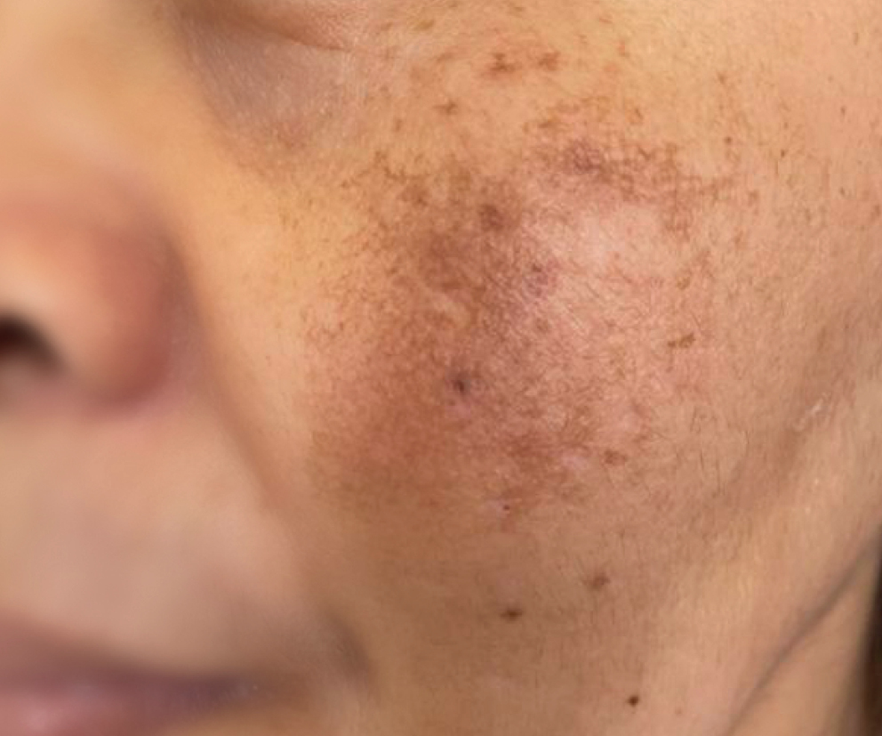
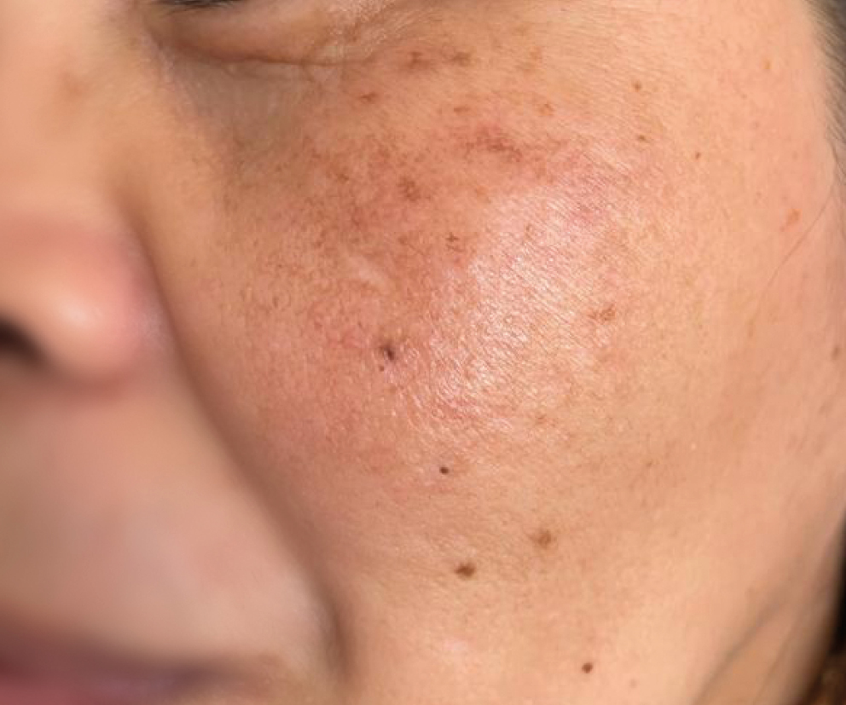
BEFORE AND AFTER RESULTS
GENDER: FEMALE / AGE 41 RESULT AFTER 30 DAYS OF TREATMENT

